Slide 1
Cooking Matters for Parents
How-To Guide
Introduction
& Tips

Slide 2
Course Overview
Facilitator
What is Cooking Matters for Parents?
A 6-week PARTICIPATORY cooking class that empowers parents with skills to EAT HEALTHY ON A BUDGET
Who is involved?
Facilitator (you!)- coordinates materials and volunteers; serves as a host for the class, provides weekly intro and wrap up for class cohesion
Nutrition Instructor- facilitates learning about healthy eating and shopping
Culinary Instructor- facilitates learning about healthy and safe food preparation
Class Assistant(s)- supports instructors and keeps class on track
The Parents!
PARENTS
Notes:
Thank you for volunteering to share your strength with members of your community! In this course, you will engage low-income adults in a series of participatory cooking classes designed to empower them to get the most nutrition out of a limited budget.
You’ll be working as part of a team for this course and will have the opportunity to get to know some wonderful members of your community. As the course facilitator you will lead your team, ensuring that volunteer instructors are recruited and trained. The nutrition and culinary instructors will lead each class using the facilitated dialogue guide found in the instructor guide book, helping the participants learn about new topics, and also share their own strengths with each other.
Classroom assistants help keep everything running smoothly and on time, providing extra assistance for activities and engaging participants. Some courses include additional assistants, such as shoppers who source the food for the class, or child care providers.
To help you navigate who does what, the slides in this presentation will be labeled in the top left corner with which team member should be responsible for completing the tasks described.

Slide 3
Facilitator
Target Audience:
Low-income parents
PARENTS
Course Basis:
Dietary Guidelines for Americans
Evidence-based guidelines
Goal: Promote good health, healthy weight, and prevent disease
Applicable for age 2 to adult, including those at risk for chronic disease
Notes:
The goal of this class is to empower low-income parents with the skills to stretch their food budgets so they can provide healthy meals at home.
Like all other Cooking Matters curricula, the Parents course uses the Dietary Guidelines for Americans and MyPlate as the foundation for basic nutrition guidelines, and builds upon these ideas, using interactive lessons to teach cooking, food safety, and food resource management.

Slide 4
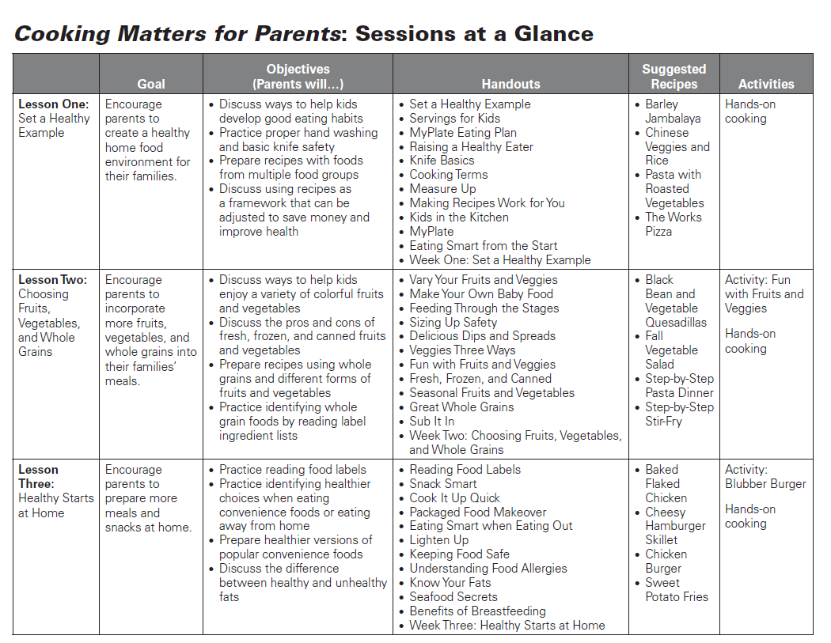
Notes:
This presentation is not meant to replace your instructor guide. The guide is the most valuable resource you have in preparing for and teaching this course, so don’t forget to look over it before and keep it on hand during each class. As we go through an overview of the course, it will be helpful to follow along in your book to see the resources as we discuss them. This and the following slide contain an overview of each CMP lesson.

Slide 5
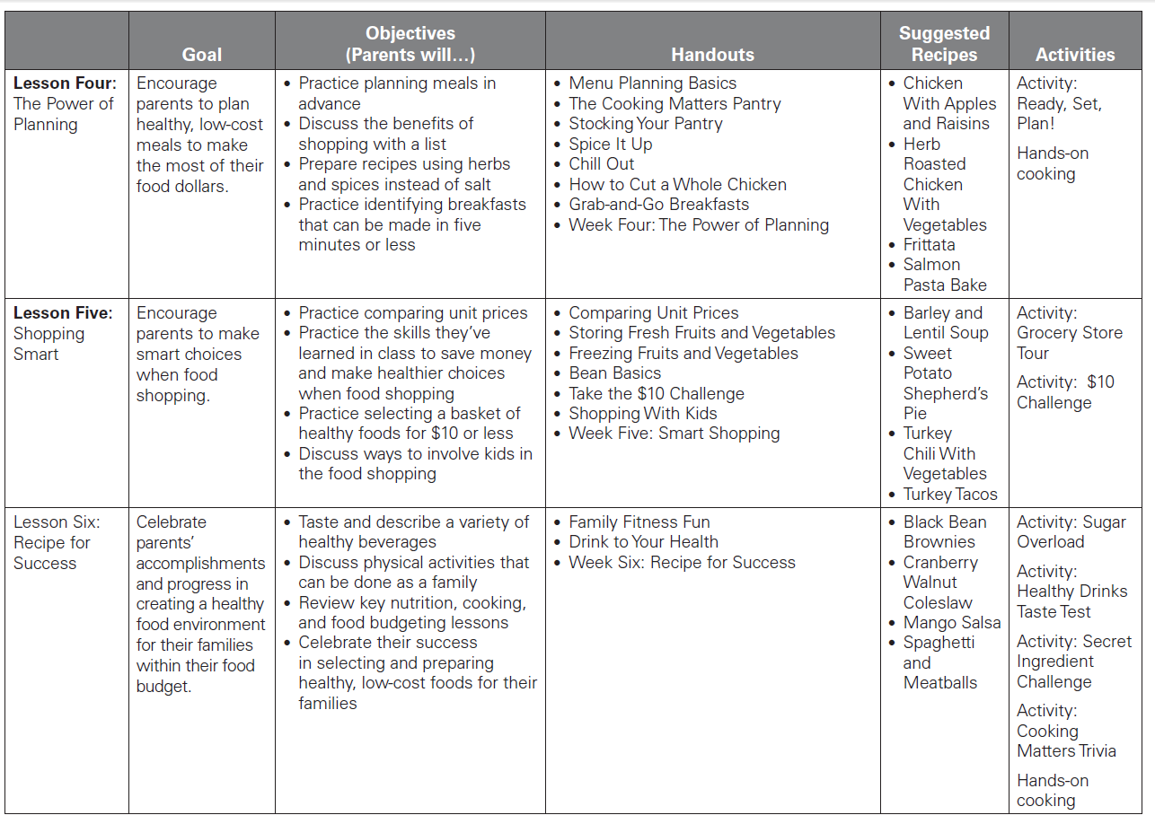

Slide 6
Preparing for the Course
Facilitator
PARENTS
Check available classroom & kitchen facilities
Learn about site rules and processes
Gather host site contact information
Example site visit photo
Notes:
An important step for the class facilitator to complete before the course is a site visit of where the class will be hosted. Visiting the kitchen and classroom areas to see what facilities are available before the course starts can help you streamline pre-class set up and avoid snags on the first day. Be sure to check what tables, chairs, white boards, and cleaning supplies are available in the classroom, and what kitchen appliances are allowed to be used and are operational. It’s a good idea to take a picture of the site so you can remember what was there when planning for your course later. It’s also very helpful to have a staff member from your host site present at the walk-through to orient you to any rules for using the facilities and inform you of policies, such as which doors are locked when, and who to call if problems arise during class.

Slide 7
Preparing for the Course
Facilitator
PARENTS
Map out your lessons
Choose promising activities
Draft a list of recipes for each week
Notes:
Taking a step back to see the big picture of the course before starting is also very helpful for the facilitator and instructors. The facilitator should look through the curriculum before the course starts and map out a schedule for using the suggested recipes and activities found in each of the six lesson plans.
While your plan might change, it’s helpful to go ahead a pick a recipe for each week to ensure you have a variety of recipe types and cooking techniques represented without repeating. For example, if you were to select veggie wraps, tacos, and burritos for your class, your participants may get tired of tortilla-based recipes. Try to mix up your meals with food like casseroles, stir fries, and sides that ensure at least 3 food groups are represented during each class. Keep in mind what kitchen facilities you observed during your site visit. If your site has a stove but no oven, for example, you should not plan on making mini pizzas or other oven-dependent recipes. Also consider what kind of take-home groceries will be needed for each week so that participants have the ingredients to make at least one recipe from class on their own. It is required that you provide take-home groceries for your Parents class, and planning for this in advance gives you adequate time to find donors and select recipes for which you will be able to supply groceries.

