Slide 1
Lesson Six: Kitchen Heroes
Celebrate kids’ accomplishments in preparing meals and snacks with fruits, vegetables, and whole grains.
Notes:
The final class in your Cooking Matters course celebrates the kids’ hard work and new knowledge. The goal is to congratulate the kids for all they’ve learned and encourage them to continue learning and applying new lessons in their everyday lives.

Slide 2
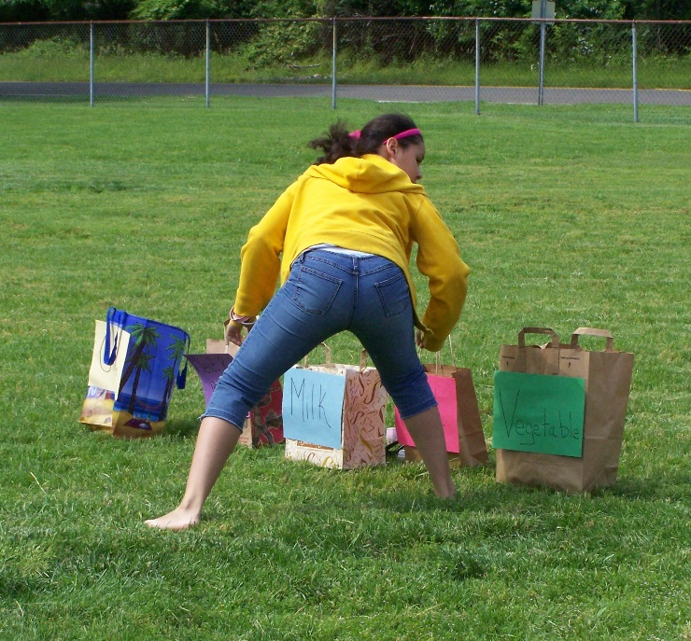
Welcome Back
Facilitator
Review
Activity Bank Activity
Revisit Week 5 Challenges
Introduce Topic for the Day
KIDS
Food Group Relay
Race Activity
Notes:
After coordinating the pre-class huddle for the teaching team and assistants, the facilitator should welcome all the kids into the classroom for the final day of class. Although today’s class is for review and celebration, stick to the familiar pattern of reviewing and sharing to open the class.
Discuss the flow of class so that the kids know what to expect from today. The flow of class plan you see listed out here is just a sample, as you might have to rearrange your class depending on the recipes you will prepare, but don’t forget to include time for surveys!

Slide 3
Set goals to continue making healthy choices after the course is over.
Nutrition
Instructor
KIDS
Trivia Activity
Notes:
After the welcome, the nutrition instructor should transition into your Cooking Matters Trivia game. As you can see, there are various ways to create this activity. Depending on your site, you can use folded pages displayed on a board at the front of class, or create a more permanent resource using laminated cards and Velcro.
Your nutrition instructor should divide the class into teams and call on them one-by-one to select questions. As the nutrition instructor reads the questions and interacts with the teams, the culinary instructor or facilitator can keep score.
If the kids are struggling with certain questions, consider jogging their memories with hints like “We talked about this type of grain when we used wheat chex in our trail mix” or, if they are stuck, give the other team a chance to answer.
If no team can answer a question, spend a minute explaining the topic again to make sure the concept is now clear.
At the end of the game, congratulate the winning team and have each child write down a goal or two they would like to continue practicing on their week 6 handout.

Slide 4
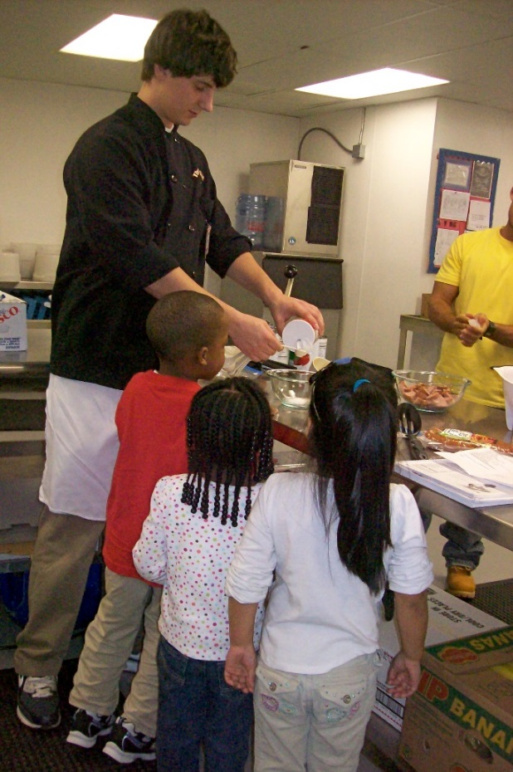
Prepare healthier versions of celebration foods
Culinary
Instructor
KIDS
Review Knife Safety
Revisit Hand Washing
Read Recipe
Cook Together
Notes:
The nutrition instructor should then pass it over to the culinary instructor for the last time as the class transitions to cooking. Walk through the familiar steps of washing hands and reading through the recipe with the group, and then discuss WHY today’s recipes are healthier than typical celebration foods. Ask the kids what other celebration foods they enjoy, and if they have any ideas on how those options could be made healthier as well.
Delegate jobs and cook together, using the time to continue conversations about what the kids learned in class and what they would like to try at home. Once your recipes are done, enjoy your celebration meal together!
Consider bringing table cloths or other simple decorations to give the room a festive feel and show they kids how proud of them you are.

Slide 5
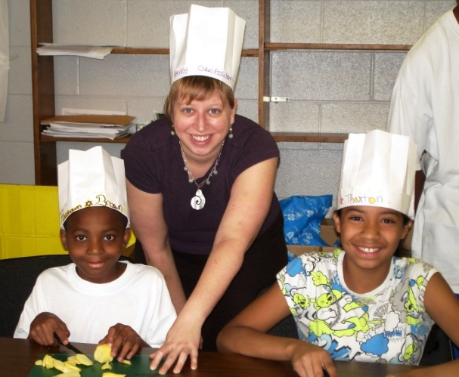
Celebrate their success in selecting and preparing healthy meals and snacks throughout the course.
Facilitator
KIDS
Eat Together
Discuss Course Impact
Graduation Ceremony
Notes:
Depending on how much time you have, you can eat and then hold your graduation ceremony, or do them simultaneously. The whole teaching team should celebrate the success of each kid by talking about something positive you’ve seen in them over the last six weeks and inviting them to share something that impacted them about class. It can be helpful to discuss this as a teaching team before the kids arrive so you can be sure you have something meaningful to say about each child during the ceremony.
This is a great opportunity to take pictures, so be sure to assign a classroom assistant the role of photographer, and send your photos to volunteers and GCFB after your class to report the hard work of your participants.
Be sure to thank the kids for all their hard work and point out that they will be able to continue learning and practicing healthy lifestyle tips and tricks as they take home their Cooking Matters books today. You can also point them to CookingMatters.org if they want to keep exploring as well. As the kids head home, make sure they each remember to take their book.

Slide 6
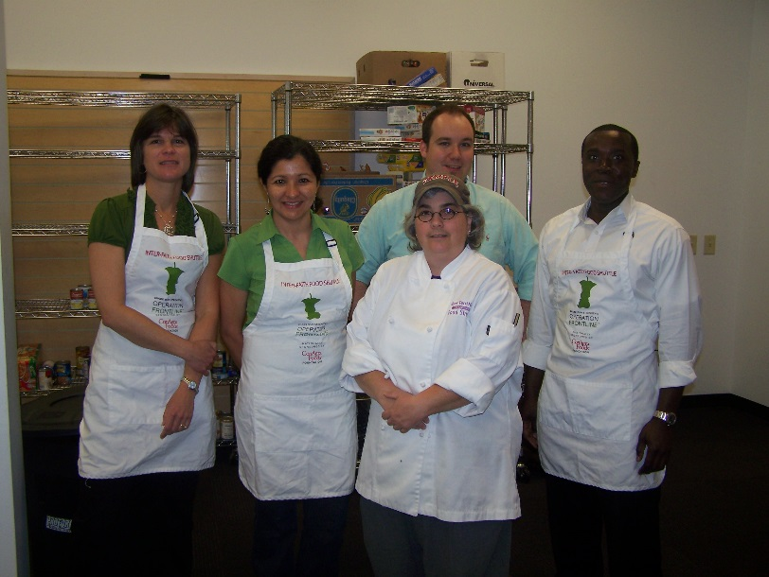
Post-Course Debrief
Facilitator
What went well?
What could we improve?
Congratulate and thank the team!
KIDS
Notes:
After the kids leave, the facilitator should be sure to lead one final debrief session with the teaching team and classroom assistants. This is a also a great time to get the whole teaching team’s input on the course overall. Discuss what went well and what could be improved, including recruitment of participants, time of class, materials provided, and any other comments volunteers might have. The facilitator should also use this time to talk to the site contact for their host site (if he or she is present) about the possibility future classes if there are any in the works.
And after 6 weeks of hard work, don’t forget to celebrate your success as a teaching team as well!
Congratulations, your team just completed Cooking Matters for Kids!

Slide 7
Reporting
Facilitator
Course Code
0 2 _ _ _ _ _
KIDS
GCFB
Code
Course Code
E-mail Course Paperwork
End-of-Course Reporting Form
Attendance sheet
Notes:
After the course is over, the facilitator should review the Satellite Partner Training and Resource Blog for instructions on how to complete end of course reporting steps.
The facilitator should complete the Course Reporting Form and Attendance sheet to cmsatellite@gcfb.org. Your course code will begin with 02 for GCFB. You are not responsible for creating your specific code. Instead, you should receive your code from GCFB in an email when we confirm that your materials have been ordered. If you are unsure about your code, please contact the Cooking Matters Satellite Coordinator at cmsatellite@gcfb.org
Please feel free to contact the Cooking Matters Satellite coordinator if you have any questions during this reporting process..

Slide 8
Thank you!
KIDS
Notes:
Thank you for your hard work in facilitating Cooking Matters for Kids in your community!

