Slide 1
Lesson Five: Super Shoppers
Encourage kids to make healthy choices away from home.
Notes:
Lesson 5 acknowledges that eating at home is not always an option for the kids, so it encourages them to make healthy choices wherever they select food. This lesson has a few different options for class activities, so it might be helpful for the teaching team to arrive a little earlier than their normal set up time if the option you choose involves lots of hands-on preparation.

Slide 2
Options for Class 5
Facilitator
1. Visit a food retailer
School cafeteria
Store
Farmers’ market
Considerations when selecting a site:
Foods to represent all sections? Healthy options?
Where do kids’ families shop?
Accessible location for class to visit?
Affordable?
Parent and store permission?
KIDS
2. Set up a mock store in your classroom
Simulate typical store layout
Prepare recipe together
Notes:
Your discussion of making healthy choices when eating away from home can be structured in a few different ways. One option, to help the kids practice this skill in a realistic context, is to actually visit a food retail establishment. This could be a supermarket, corner store, or even the kids’ own cafeteria, but there are a few criteria you should consider in selecting your location. First, your retail location should offer at least some representation of the items in each section of the activity. Each section should ideally have a few options for items so the kids get practice making healthy choices. The location you choose should also be a venue the kids would likely visit in their everyday lives. Consider using a store close to school or their neighborhood that sells affordable items.
Regardless of the site you decide to use, the facilitator should prepare for this week by seeking permission from the parents and the store manager for the fieldtrip, so be sure to decide on your plan a few weeks in advance.
If visiting another location does not appear to be the best option for your group, you can also set up a mock store in your normal classroom setting. Look over the “Can I Have This One?” activity in your instructor guide, and gather the necessary items in the weeks leading up to lesson 5.

Slide 3
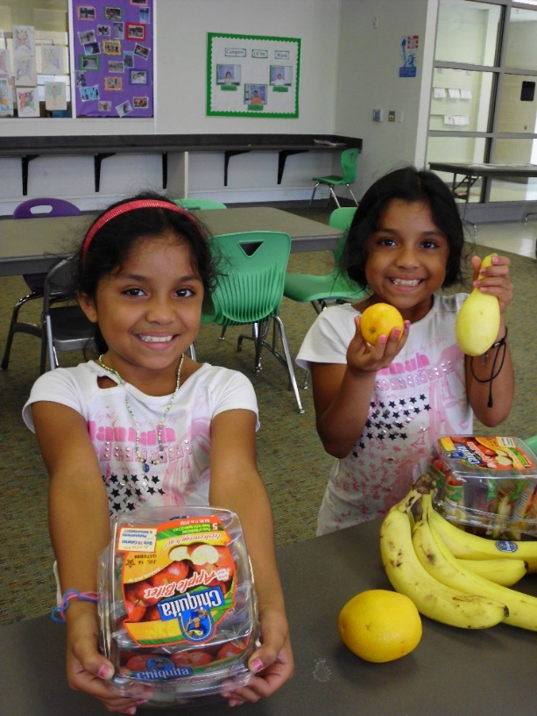
Welcome Back
Facilitator
KIDS
Review
Activity Bank Activity
Revisit Week 4 Challenges
Introduce Topic for the Day
Notes:
Depending on how you decide to run lesson 5, the introduction for this class could follow the established pattern, or be shortened to allow time for a fieldtrip. Regardless of whether you choose to include a physical activity today, though, be sure to save some time to discuss the challenge activity from last week before jumping into today’s lesson.

Slide 4
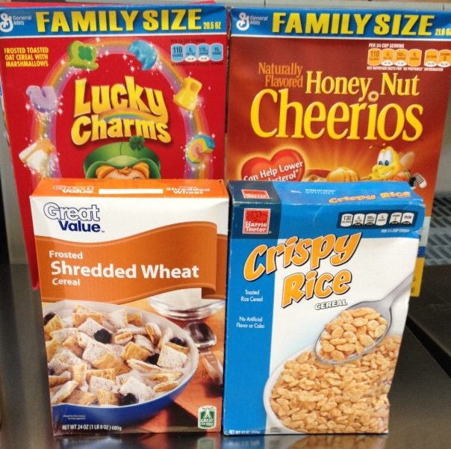
Practice making smart choices at the grocery store
Facilitator
Culinary
Instructor
Nutrition
Instructor
KIDS
“Can I Have This One?” – Page 18
Notes:
Be sure that everyone on your teaching team reads the “Can I Have This One” activity in your instructor guide before this week so everyone is able to help it run smoothly. If you are visiting a food retail location, the facilitator should do a walk-through before the day of class so that they can prepare the other instructors to lead the kids to the appropriate areas of the store. This site visit should also include a discussion with the store or site manager to seek permission for and explain the purpose of the visit.
If you are setting up a mock store in your classroom, try to create realistic sections of food, and print out signs to help the kids imagine the real location.

Slide 5
Practice making smart choices at the grocery store
Facilitator
Culinary
Instructor
Nutrition
Instructor
KIDS
“Can I Have This One?” – Page 18
Notes:
The nutrition instructor should introduce the activity and split the class into 6 groups, ideally of 2-4 kids each. Distribute and explain the worksheet for the activity, and send each group to a station. Remind the kids that the items they see are just for display and should not be eaten. Each member of the teaching team should man one of the stations to help the kids think through the worksheet and relate the section to past lessons about MyPlate and nutrition labels. If you do not have enough instructors for each of the 6 stations, you can divide your kids into fewer groups. Just make sure there’s a teaching team member at each station where children are present.
Be sure to discuss how long you plan to spend on this activity before class as a teaching team, and appoint one instructor or volunteer as the timekeeper to keep all rotations on track.

Slide 6
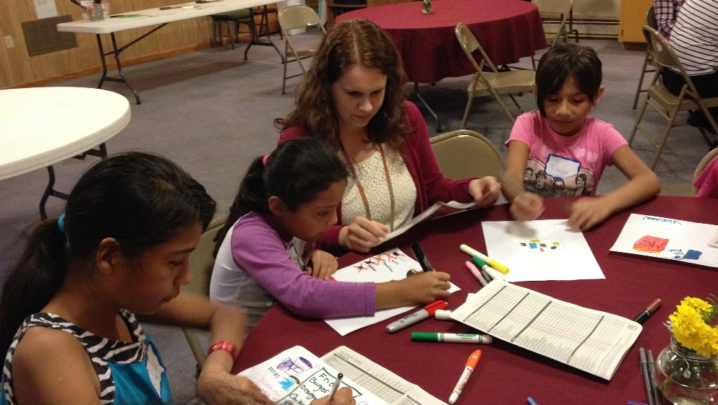
Practice identifying fruits, vegetables, and whole grains when they are out to eat
Nutrition
Instructor
KIDS
Practice sharing with their families what was learned in class.
Drawing fast food orders using printed menus
Notes:
Using your instructor guide’s facilitated dialogue outline, the nutrition instructor should transition into a discussion of how to eat healthy when eating away from home. As your guide indicates, you can also cover this topic while eating together today to save time, or during your final class if you are traveling off-site for a store visit.
Follow your instructor guide’s outline for this discussion, and consider ways to make it hands-on. The facilitator could bring cut-out photos of food or fast food menus to help the kids practice choosing items with healthy fruits and vegetables. You could also include a role play, with one instructor pretending to be a restaurant or cafeteria worker, and invite the kids to come up and make an order.
As with all the lessons in this class, end the nutrition lesson today by asking the kids what they will take home to share with their family and friends.

Slide 7
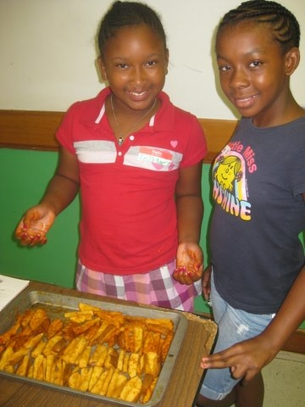
Prepare healthier versions of popular fast foods.
Culinary
Instructor
KIDS
Discuss Fast Food
Review Food Safety
Read Recipe
Assign Roles
Notes:
The cooking and food safety lesson today gives the kids a chance to learn about cooking methods and ingredient substitutions to make versions of popular fast foods at home. Using your instructor guide’s outline and the patterns you have established during class, the culinary instructor should lead the kids in looking over the recipe and preparing to cook. As your guide notes, this lesson is a great one to include teaching on how to handle raw meat safely, so be sure to cover this if applicable.
As always, some of the suggested recipes for this lesson have significant cook time, so be sure to read over the recipe when deciding what to select as a teaching team. Off-site store tours will restrict the amount of time you have to cook, but classes holding mock store tours in the classroom could opt to cook before the nutrition lesson so that kids can complete the tour while the food is in the oven.

Slide 8
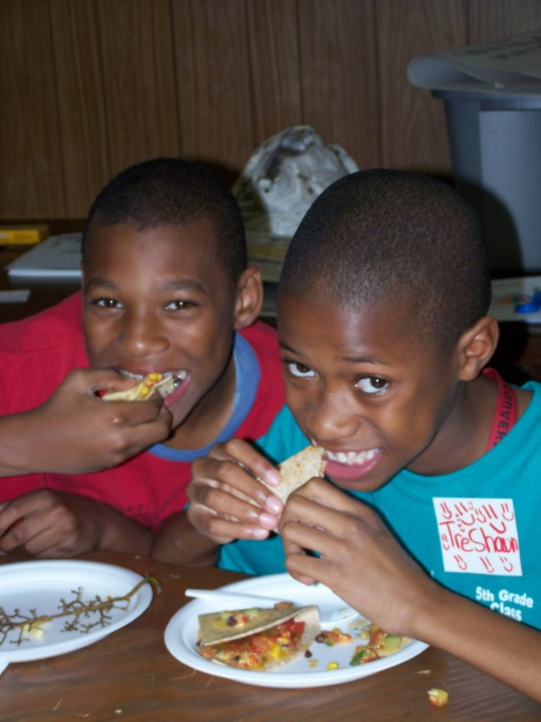
Facilitator
Eat Together
and Wrap Up
KIDS
Serve, eat, clean-up
Weekly Challenge – Page 17
Review lesson
Goal Setting
Debrief
Notes:
Once the food is ready, eat together as a class and discuss any leftover portions of the nutrition lesson if you opted to cover them here.
Once the group is done eating, the facilitator should transition the class into the weekly challenge discussion time and let the kids share what they’ve. After cleaning up together, say good-bye to the kids and meet for your closing huddle with the teaching team. Be sure to talk about any special arrangements you need to make for graduation during the next course, what recipes you will be preparing, and how you will structure the class to accommodate those recipes.

