Slide 1
Lesson Four: Smart Snackers
Encourage kids to make healthy snack and beverage choices.
Notes:
Snacks can be a common occurrence in the life of a kid, so Lesson 4 is dedicated to helping the kids identify and choose healthy snack foods and drinks.

Slide 2
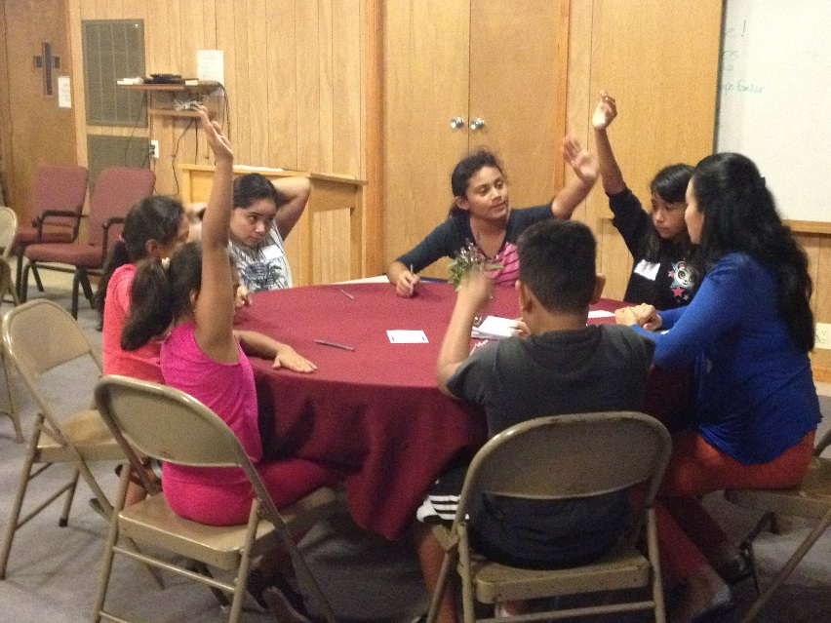
Welcome Back
Facilitator
KIDS
Review
Activity Bank Activity
Revisit Week 3 Challenges
Introduce Topic for the Day
Notes:
You may notice that this slide is identical to the introduction slide for the previous class. The kids should be familiar with the pattern by now, and the facilitator should lead the class in a physical activity from the Activity Bank to get things started for the day.
Next, the facilitator should run through the same review and challenge activity sharing process. Although these steps might seem repetitive week after week, the sharing time is important for helping the kids relate to the lesson in their everyday life, so don’t be afraid to spend a few minutes hear listening as the kids share. Celebrate their work towards their goals, and then introduce Lesson 4.

Slide 3
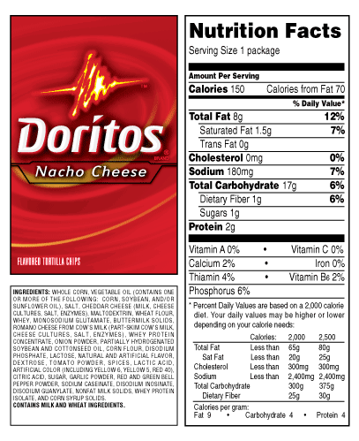
Practice reading food labels.
Nutrition
Instructor
KIDS
Label Lingo – Page 14
Notes:
Using your instructor guide’s facilitated dialogue outline, the nutrition instructor should get the kids talking about drinks they enjoy and why we should try to limit the amount of sugary beverages we choose.
Using the handout on page 14, introduce nutrition labels and explain how they tell us information about what is in our food and drinks. As you can see from the handout, the kids curriculum focuses on a few select parts of the nutrition label. While there is a wealth of information on the label, keeping your discussion on the level of your class is important here. Discuss how to determine how many servings are in a package and the amount of sugar in one serving versus the whole package. If you have older kids, feel free to discuss other aspects of the label as discussed in the tip box on page I-18.
For all ages, it’s helpful to bring in examples of food and drinks so the kids can see where the nutrition label is located on a package. The facilitator should try to find a variety of items common for the kids, and include a few examples of items with more than one serving in a package so the nutrition instructor can discuss this with the class.

Slide 4
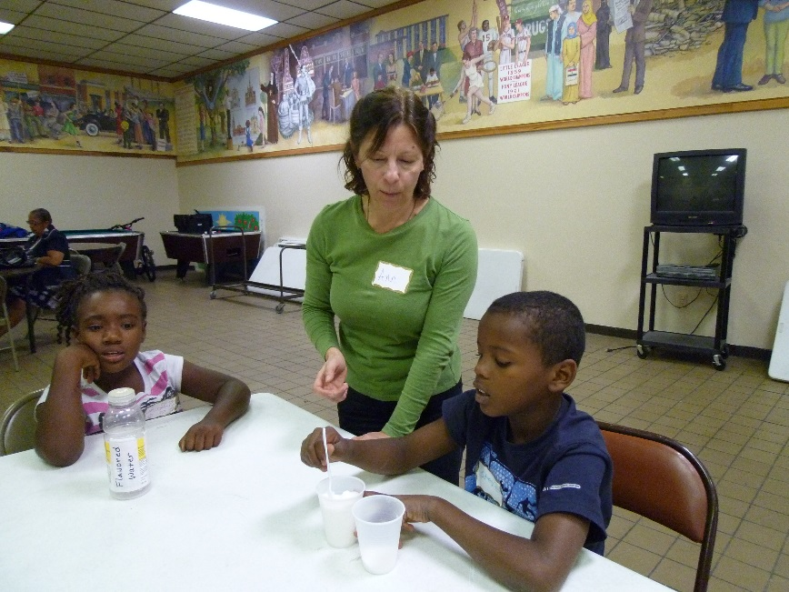
Taste and describe a variety of healthy beverages
Nutrition
Instructor
KIDS
Sugar Overload Activity
Discuss healthier options
Practice sharing with their families what was learned in class.
Notes:
This lesson includes an activity that has proven very popular and impactful called Sugar Overload. The facilitator and instructors should read over the activity and gather sugary beverage bottles or nutrition labels, as well as sugar and other measuring materials listed in the activity overview. If you wish to reuse materials for future courses, the facilitator can store the supplies for the next class.
Keep in mind your kids’ comfort level with math may vary when leading Sugar Overload. Be sure that you are comfortable explaining the calculations before class, provide calculators, and keep an eye out for kids who seem to need a little extra help during the activity.
Because this activity includes asking the kids to measure out sugar, consider completing it somewhere clean up would be easy, such as an uncarpeted area, or making sure you have access to supplies such as a vacuum cleaner. Planning ahead for this keeps the stress level of your teaching team low, and your host site happy.

Slide 5
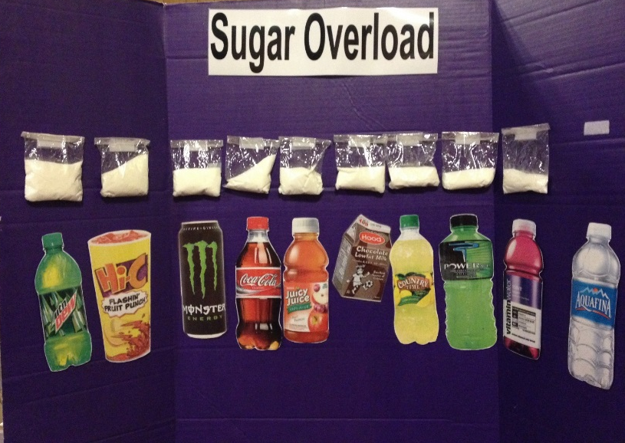
Taste and describe a variety of healthy beverages
Nutrition
Instructor
KIDS
Sugar Overload Activity
Discuss healthier options
Sample board after answers revealed
Notes:
If you need an abbreviated version of the activity due to time constraints, or if measuring out sugar is not possible for your group of kids, consider creating an interactive display like the one pictured here. With this version of the activity, kids are asked to rank laminated beverage photos in order on a Velcro board, from lowest to highest sugar content. The nutrition instructor then reveals the correct answer and places prepackaged bags of sugar on the board above each photo using Velcro.
This version of the activity saves time, but is less hands-on. If you opt for this version, consider including other ways to engage your kids, like making them stand up and rearrange themselves to create the hypothesis line up as they each hold a drink photo. You can also build excitement in as the nutrition instructor reveals the actual rankings one-by-one by asking the kids for a drum roll before revealing each ranking. As you reveal the answers from lowest to highest, be sure to talk about WHY each drink has more sugar. For example, the nutrition instructor could ask “Why do you think chocolate milk has more sugar than regular?” or “What could you choose if you want milk, but something with less sugar?”
With any version of this activity, be sure to give the kids concrete ways they can choose drinks with less sugar, using the handout on page 15 for ideas if needed.

Slide 6
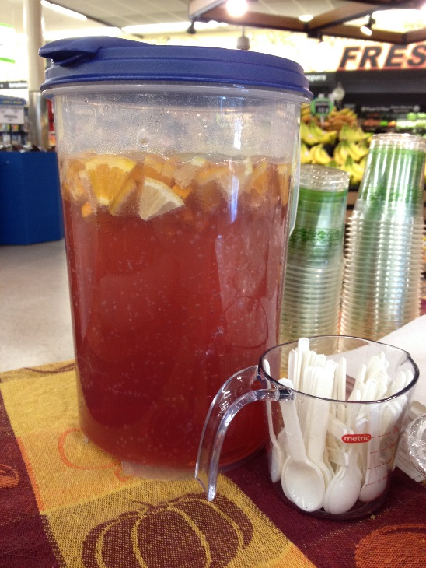
Prepare simple snacks they can make at home on their own
Culinary
Instructor
KIDS
Discuss Snacking
Review Food Safety
Read Recipes
Assign Roles
Notes:
The nutrition instructor should then pass it over to the culinary instructor for a discussion of healthy snack foods. This is a great lesson to review MyPlate’s food groups from lesson 1 as you ask the kids about what snacks they typically enjoy and what food groups those fall into. After explaining that snacks are a good way to fit in healthy fruits and vegetable, brainstorm with the kids what snacks they could choose with these items. Use the handouts on pages 15 and 16 for ideas, and consider having the kids flip through the snacks and sides section of recipes at the back of their book. Connect the lesson to your previous discussion of healthy beverages and to the idea of eating breakfast everyday, following the outline in your instructor guide.
When selecting the recipes to make this week, try to choose at least one snack and one beverage. Select some of the options listed on the handouts you used in class today, the recipes in the back of the book, or drinks from the healthy drink taste test activity.
Use your established patterns of washing hands, reading the recipe, and setting up your work space with the kids. As you cook, as them what they will share at home this week, and what recipes they would want to try.

Slide 7
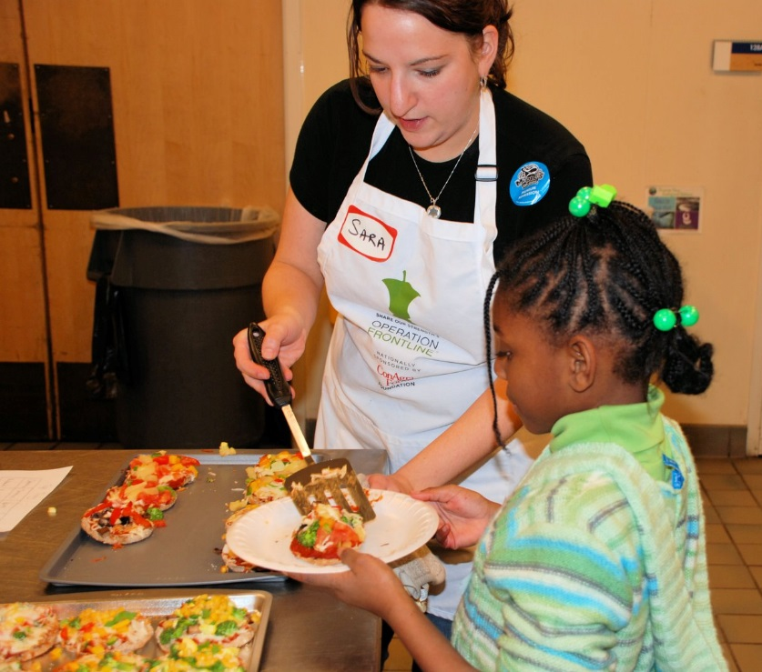
Facilitator
Eat Together
and Wrap Up
KIDS
Serve, eat, clean-up
Weekly Challenge – Page 13
Review lesson
Goal Setting
Debrief
Notes:
While eating together today, continue discussing the key messages you went over today. You can even have the kids look at the nutrition labels on the ingredients they used to cook today to connect the various topics you discussed.
Once the group is done eating, the facilitator should transition the class into the weekly challenge discussion time and let the kids share what they’re planning to work on. After cleaning up together, say good-bye to the kids and meet for your closing huddle with the teaching team.

