Slide 1
Lesson Six: Recipe for Success
Celebrate participants’ accomplishments and process in selecting and preparing healthy meals within their food budget.
Notes:
The final class in your Cooking Matters course returns to the classroom for a celebration of your participants’ hard work and new knowledge. The main objective for this week is summing up and celebrating the lessons and skills the class has learned so far. This sets your participants up well to continue learning and applying new lessons in their everyday lives.

Slide 2
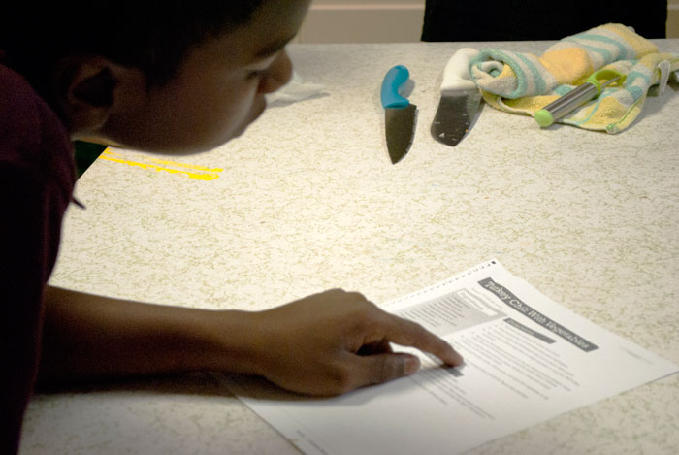
Welcome Back
Facilitator
ADULTS
Review
Revisit Week 5 Challenges
Introduce Topics for the Day
After-class Surveys
Notes:
After coordinating the pre-class huddle for the teaching team and assistants, the facilitator should welcome all the participants into the classroom for the final day of class. Although today’s class is for review and celebration, stick to the familiar pattern to open the class.
Discuss the flow of class as you have chosen to run it, explaining that you will be completing a secret ingredient cooking challenge if that has been set up by your team, followed by eating together and a graduation ceremony. Mention that, before you get started on the day’s festivities, you need the class to finish up the second portion of their e-surveys. Give them time to complete this now, helping participants with questions or those with challenges reading as necessary. Your instructor guide recommends doing these after the graduation ceremony, but we have found that participants are more willing to complete the surveys before the course wraps up.

Slide 3
Discuss ways to be more physically active
Nutrition
Instructor
ADULTS
Benefits of Physical Activity
Barriers to Physical Activity
Ways to be Active
**Note: Sugary beverages should be addressed if not covered in Lesson 3**
Notes:
If your team has followed our recommendation of moving the discussion of sugary beverages to lesson 3, you can start this class by talking about physical activity’s role in creating a healthy lifestyle. Use your instructor guide for guidance on leading this discussion. With this discussion in particular, it’s important to remember the scope of this course, that we are learning about the basics of a healthy lifestyle in general. If participants begin asking detailed questions about chronic diseases or other health conditions as you discuss the benefits of physical activity, you should direct them to reliable sources of information, but avoid spending class time making specific recommendations for diseases and conditions.
Emphasize that physical activity can take many forms and give participants time to share their preferred types or tips on how they make their days more active.

Slide 4
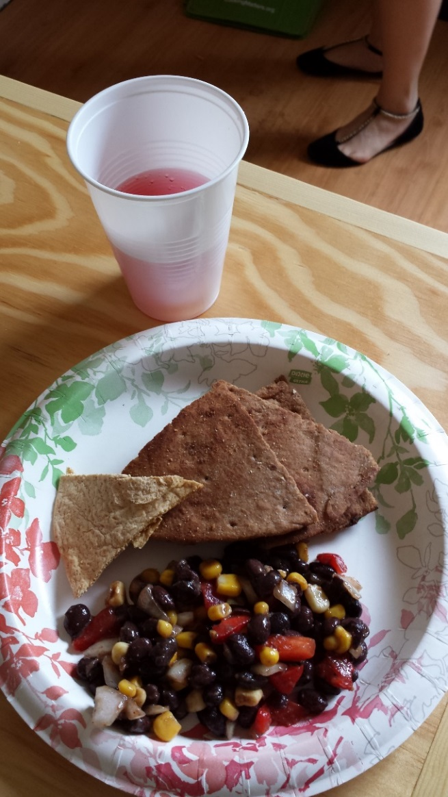
Prepare Celebratory Recipe Together
Culinary
Instructor
ADULTS
Review Knife Safety
Revisit Hand Washing
Read Recipe
Cook Together
Notes:
Depending on the recipe you choose for graduation, you can cook after the trivia game or before if the recipe has significant cook time. During cooking, the teaching team should continue engaging the participants in conversations about how various aspects from the course are represented in the recipes you are preparing. For example, if you are preparing the Mango Salsa you can ask the participants what substitutions they could make if mangoes were not available and how seasonal items could be incorporated.

Slide 5
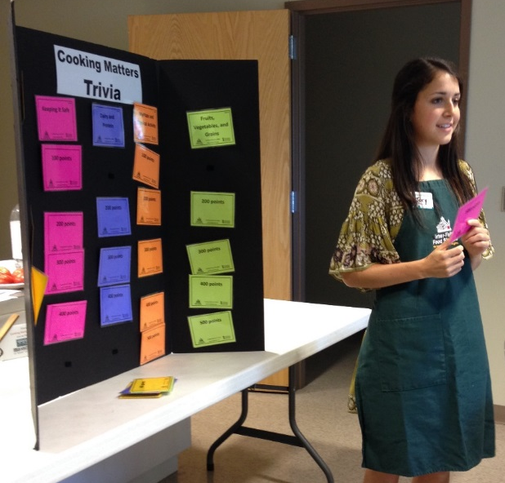
Review key nutrition, cooking, and food budgeting lessons.
Nutrition
Instructor
ADULTS
Trivia Activity
Eat Together
Notes:
Transition into your Cooking Matters Trivia activity at the point in class that your teaching team has determined it best fits. As you can see, there are various ways to create this activity. Depending on your site, you can use folded pages displayed on a board at the front of class, or create a more permanent resource using laminated cards and Velcro.
Your nutrition instructor should divide the class into teams and call on them one-by-one to select questions. As the nutrition instructor reads the questions and interacts with the teams, the culinary instructor or facilitator can keep score.
If participants are struggling with certain questions, consider jogging their memories with hints like “We talked about this type of grain when we used brown rice in that stir fry recipe” or, if they are stuck, give the other team a chance to answer.
If no participants can answer a question, spend a minute explaining the topic again to make sure the concept is now clear.
At the end of the game, congratulate the winning team and transition into cooking together or eating, depending on the order of class you have established. You can also play the trivia game while eating if you are crunched for time.

Slide 6
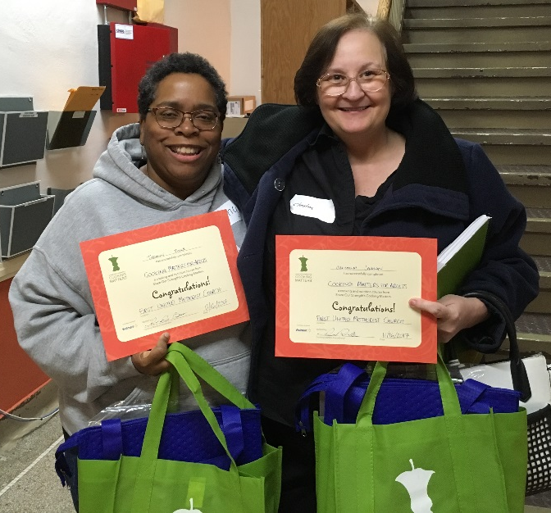
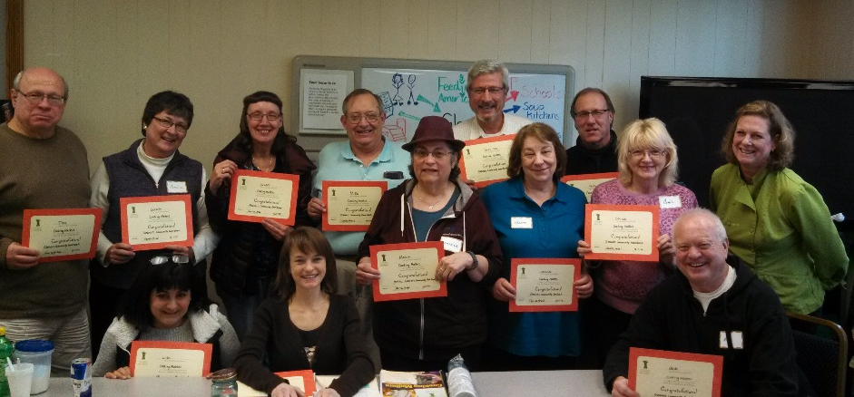
Celebrate their success in selecting and preparing healthy, low-cost foods.
Facilitator
ADULTS
Eat Together
Discuss Course Impact
Graduation Ceremony
Notes:
As participants finish eating, it’s time for your graduation celebration! Celebrate the success of individuals participants by talking about something positive you’ve seen in them over the last six weeks. This is a great opportunity to take pictures, so be sure to assign a classroom assistant the role of photographer, and send your photos to volunteers and Gleaners Community Food Bank after your class to report the hard work of your participants. Ask participants if they would like to share anything with the class and if there are any goals they would like to continue to work on in the future.
Participants that did not attend at least 4 of the 6 courses cannot be counted as graduates, but you should still celebrate their success by calling them up to say how you’ve seen them grow. Be sure to tell them that you are proud of them and glad they attended!
Thank the class for all their hard work and point out that they will be able to continue learning and practicing healthy lifestyle tips and tricks as they take home their Cooking Matters participant guides today. You can also point them to CookingMatters.org if they want to keep exploring as well. As the participants head home, make sure they each remember to take their workbooks

Slide 7
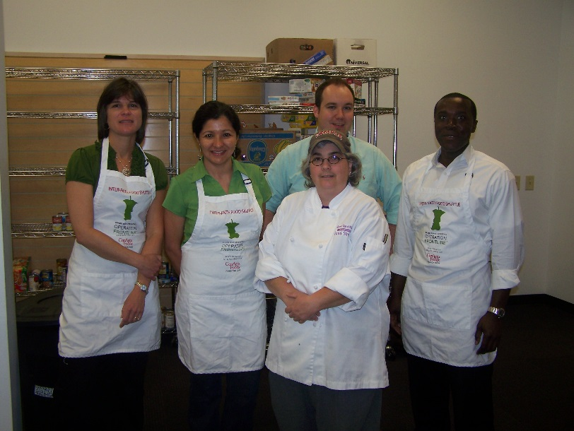
Post-Course Debrief
Facilitator
What went well?
What could we improve?
Congratulate and thank the team!
ADULTS
Notes:
After your participants have left, the facilitator should be sure to lead the usual debrief session with the teaching team and classroom assistants. This is a also a great time to get the whole teaching team’s input on the course overall. Discuss what went well and what could be improved, including recruitment of participants, time of class, materials provided, and any other comments volunteers might have. The facilitator should also use this time to talk to the site contact for their host site (if he or she is present) about the possibility future classes if there are any in the works.
And after 6 weeks of hard work, don’t forget to celebrate your success as a teaching team as well!
Congratulations, you’ve just completed Cooking Matters for Adults!

Slide 8
Reporting
Facilitator
Course Code
0 2 _ _ _ _ _
ADULTS
GCFB
Code
Course Code
E-mail Course Paperwork
End-of-Course Reporting Form
Attendance sheet
Notes:
After the course is over, the facilitator should review the Satellite Partner Training and Resource Blog for instructions on how to complete end of course reporting steps.
The facilitator should complete the Course Reporting Form and Attendance sheet to cmsatellite@gcfb.org. Your course code will begin with 02 for GCFB. You are not responsible for creating your specific code. Instead, you should receive your code from GCFB in an email when we confirm that your materials have been ordered. If you are unsure about your code, please contact the Cooking Matters Satellite Coordinator at cmsatellite@gcfb.org
Please feel free to contact the Cooking Matters Satellite coordinator if you have any questions during this reporting process.
Thank you for your hard work in facilitating Cooking Matters for Adults in your community!

