Slide 1
Lesson One:
Let’s Get Cooking!
Introduce participants to tools they can use to choose and prepare healthy foods at home.
Notes:
Now that we know how to find resources in our instructor guide, let’s take a closer look at the lessons themselves.
The first Cooking Matters for Adults lesson introduces the participants to what your Cooking Matters class will be like, and also helps them begin to approach healthy eating and cooking.
The facilitator, nutrition and culinary instructors, as well as any class assistants should plan to arrive at the course site at least 30 minutes ahead of the class’ start time to talk about the game plan for day and help prepare the classroom and cooking areas.

Slide 2
Enrollment & Surveys
Facilitator
Pre-class E-survey
Participation Waivers
Note All Allergies
Attendance Sheet
ADULTS
Notes:
As the participants arrive, it’s a great time to start filling out the pre-class e-survey. Let participants know that this is not a test and that all answers will be kept confidential, but that the survey is required to enroll in the class.
Participants who finish early can create name tags for themselves and browse through their participant guides while waiting for the others to finish. As you are planning for the first class, be aware that this process could take up to 15-30 minutes.
Ensure that all e-surveys have been uploaded by asking each participant to show you the “thank you” screen. Don’t forget to thank them for filling it all out!

Slide 3
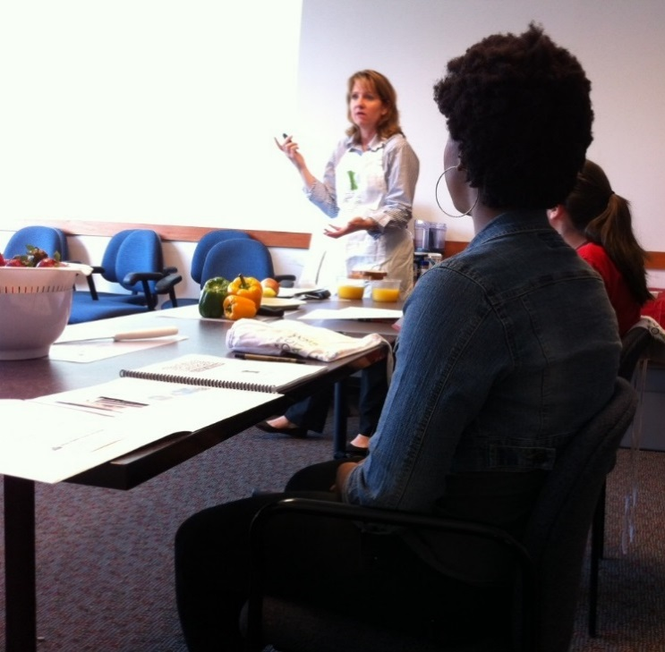
Facilitator
Welcome
Course Reminders
Cooking Matters Overview
Introductions
Class Expectations
ADULTS
Notes:
Before jumping into the curriculum, it’s important for the facilitator to welcome the participants and create a class atmosphere where they feel comfortable and engaged. The facilitator should give a brief overview of what the class can expect each week. The overview should include that the course will occur at the same time and place for 6 weeks, and that each week families can expect to learn about healthy eating, shopping, and hands-on cooking skills where they will get to eat what they prepare afterward. If your course will include a grocery store tour in the 5th week, be sure to mention that now and let the participants know that you will remind them of the change in location as that week approaches.
The facilitator should take time to introduce themselves next, and their volunteers should do the same, offering information that will help the participants relate with you. Next, let each participant introduce themselves. Consider asking an ice breaker question, such as “what would be the one food you would want if you were stranded on a desert island?” and “What would you like to learn from this class?” This gets everyone comfortable talking with the group and increases the likelihood they will feel comfortable participating in the future.
The facilitator should take notes during these introductions, or ask one of the assistants to take notes on their behalf. It’s important to connect with your participants and remember the information they share can help you tailor future lessons to include their specific interests.
Lastly, the facilitator should guide the participants in creating a code of conduct for the class. Have the nutrition or culinary instructor write the class’ ideas on a flip-chart paper or poster that can be posted each week. After asking for suggestions, the facilitator should guide the class towards rules that promote positive attitudes toward food and working together in the classroom. These could include : we wait until everyone is served to eat together, don’t bad-mouth foods so that everyone can enjoy trying them, be open to trying new foods, and work as a team on all activities.

Slide 4
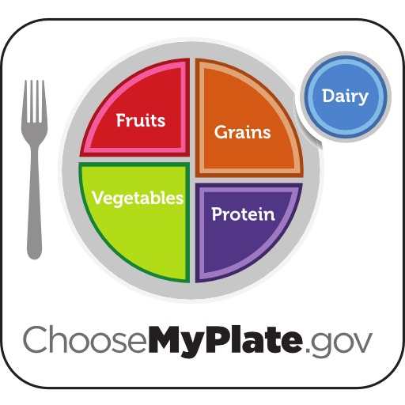
Practice recipes with foods from multiple food groups.
Nutrition
Instructor
ADULTS
Facilitated Dialogue
Healthy Eating
MyPlate – Page 2
Notes:
Now it’s time to transition into the nutrition portion of the lesson. At this point, the facilitator should get the participants excited to talk about the nutrition lesson and invite the nutrition instructor up to lead it. Begin a conversation about healthy eating and why participants do or do not think it is important.
With a poster of MyPlate displayed where all participants can see it, use facilitated dialogue to get the group talking about what they know. (Facilitated dialogue:
A method of group teaching that involves active participation of both the learner and the educator, recognizing participants as experts in their own lives and encouraging sharing)
Instead of just telling them about the food groups represented, try to ask open ended questions, such as “Can anyone tell me about where they have seen this before?” and “What do you know about MyPlate?” Your instructor guide lays out many helpful questions for this discussion on page I-2.
Don’t forget to get all participants talking! If certain individuals are dominating the conversation and others are not contributing, consider including questions such as, “What about this side of the room, who wants to share about where they’ve seen this type of poster before?”
Be sure to read over the instructor guide before leading this discussion to make sure you cover all the topics, such as food groups, “always versus sometimes” foods, portion sizes, and mixed dishes.
After discussing the basics, consider making it personal by bringing the conversation back around to the favorite foods list mentioned introductions.
Using your own favorite as an example, talk about the food groups involved. Then challenge the participants to discuss what their favorites contain with their tables. Gently correct mistakes, and consider discussing other common dishes like pizza or salad, and how you could add additional food groups.

Slide 5
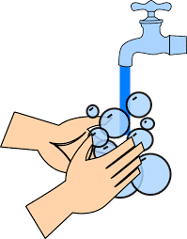
Practice proper hand washing and basic knife safety
Culinary
Instructor
ADULTS
Hand Washing
Knife Basics – Page 15
Cooking Terms – Page 17
Measure Up – Page 18
How to Use Recipes
Notes:
After the nutrition lesson, it’s time to transition into the cooking portion of the class. The culinary instructor should continue to use facilitate dialogue by asking questions based on the ones outlined in your instructor guide, such as “What’s kind of things do you usually like to make in the kitchen?”
This is the first time you have cooked with the participants, and it might even be the first time they have cooked in general. This week you will be spending more time teaching the basics of safety and how to approach working in the kitchen before jumping in to the hands-on cooking portion. Talking to the participants about WHY they think it’s important to wash their hands and materials when cooking during this lesson will help create good food safety habits that they will use in your class in future weeks and hopefully beyond.
After discussing sanitation and food safety, have the participants wash their hands and gather around while the culinary instructor does a cooking skills demonstration. As some participants might have very little cooking experience, be sure to SHOW them tasks you will be asking them to do in the class, especially basic knife skills, and be sure to demonstrate tasks, like the size of cut you want for vegetables. Pay attention to the skill level of your participants to gauge what kitchen experience they already have and what you should focus on in the future, as this will differ for each class.
Some individuals may feel less comfortable than other during the cooking activities, and might be hesitant to step up for tasks. The culinary instructor should make an effort to monitor the division of labor and try to make sure all participants get hands-on experience and learn new skills. Some shy participants might be willing to try a task if directly asked to do it, and others might respond better to invitations from the culinary instructor such as “Would you like to help me and get some practice chopping potatoes?” Using cooking time to continue conversations with participants is a great way to help you gauge their experience and comfort levels in the kitchen.
After you are finished working through the discussions and demonstrations outlined in your instructor’s guide lesson, introduce the recipe you have chosen from the book’s list of suggested recipes. This is a great time to get the class engaged in helping you read through the icipants who may have never cooked from a recipe before how to approach it and prepare materials before starting to cook. recipe, and to teach part
It is always a great habit to tie in lessons learned from the nutrition discussion and previous weeks’ lessons during the cooking portion of the class as well. Consider quizzing participants on where certain ingredients fit on MyPlate and how the recipe can be adapted to include all food groups.

Slide 6
Discuss using recipes as a framework that can be adjusted to save money and improve health.
Culinary
Instructor
Page 19
Discuss substitutions
ADULTS
Solicit opportunities for substitutions
Making Recipes Work for You – Page 19
Notes:
This lesson includes discussing recipe frameworks and adaptations. Be sure to look over this section closely as a teaching team to be sure you are familiar with the resources your instructor guide has, and then use them to guide the participants through a discussion of how to make recipes work for the ingredients they have on hand. The talking points in your instructor guide are very helpful for this section. These additional resources include templates such as “Side Dishes Made Simple,” “Sauces Made Simple” and many more. Today you are just introducing the idea of recipe flexibility. You will go more in-depth on the topic in Lesson 4 when you cover meal planning.

Slide 7
Practice reading food labels.
Nutrition
Instructor
ADULTS
Reading Food Labels – Page 3
Portion Distortion – Page 4
Notes:
Now it’s time to return to the second nutrition portion of the lesson while the food cooks. If the recipe you selected does not require downtime for cooking, feel free to combine the two nutrition sections of this lesson before the cooking and simply eat as a class afterwards. It’s up to you and your teaching team whether you want to split your nutrition lesson each week, combine it, or even put the culinary portion of the class first on weeks with lots of wait time during cooking. Discuss this as a team in light of the upcoming recipes and activities at least the class before so that all volunteers are on the same page as to the flow of class.
As you return to the nutrition lesson, continue using facilitated dialogue to discuss nutrition labels, first feeling out if participants have used them in the past and what information they usually pay attention to. Using the handout on page 3, discuss the various parts of the label. You can make this portion of the class hands-on by using the nutrition labels on the ingredients you used to cook, asking participants to find information like serving size and grams of fat. Consider bringing labels from other common items, or bring similar ingredients to compare, such as regular versus no salt added canned items, whole wheat versus regular grains, or regular versus reduced fat dairy.

Slide 8
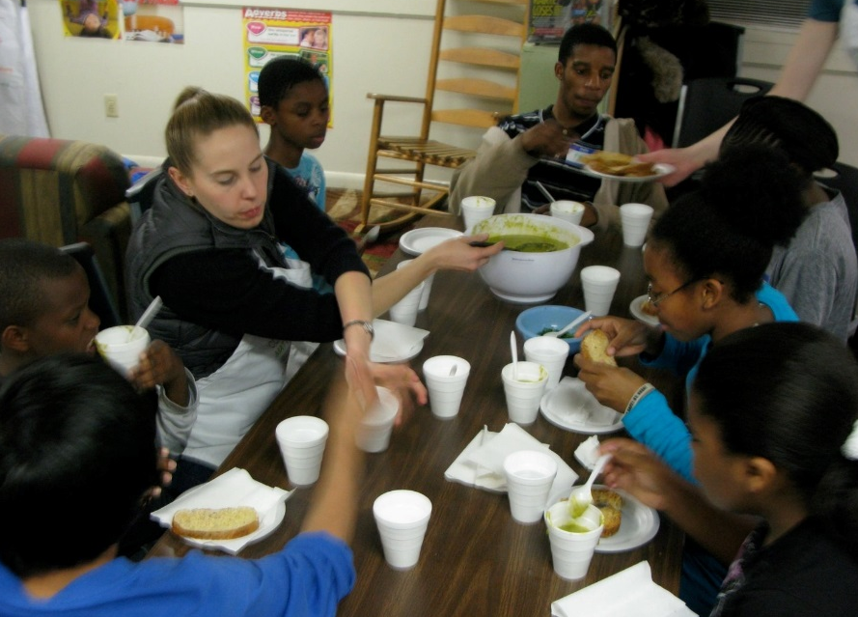
Facilitator
Eat Together
and Wrap Up
Serve, eat, clean-up
Review objectives
Weekly Challenge – Page 55
Goal Setting
ADULTS
Notes:
Once all the food is ready, it’s time to enjoy what you cooked together as a class! The goal is to create a family-like setting where everyone eats together and feels comfortable joining in conversation. Instructors, assistants, and the facilitator should also eat with the participants, dispersing themselves around the tables for easier conversation.
Meal time is a great time to get a feel for how much the participants understood the lesson, and it also gives participants an opportunity to ask questions. All volunteers should look over the instructors guide’s “Eating Together” section for help guiding the time.
This week’s lesson lends itself well to quizzing the adults on what MyPlate food groups they’re eating and asking what topics the participants hope to learn about during the class.
As the participants finish eating, the facilitator should bring the group back into one unified conversation. The facilitator can ask what the participants enjoyed, summarize the lesson’s key messages, and introduce the weekly challenge.
Your instructor guide has options listed for a participant challenge each week. Present these options to the group, give them time to talk amongst themselves, and have them select one particular goal. It’s helpful to have the goal handout printed out so that participants can circle the one they suggest and hang it on their refrigerator at home. Deciding on their goal in class and sharing it with you will make them more likely to take ownership of the change and attempt to make it happen. Be sure to remind them that you will be asking them to report back about how the challenge went when you meet next class.
After the group has set their goals, have class members help you clean up. The facilitator should delegate tasks to get participants involved in washing dishes, cleaning the kitchen, and rearranging the classroom as needed.
Once the site is cleaned and materials are properly stored, thank the participants for coming and pass out the take-home groceries. These grocery bags can be prepared before the class or filled in an assembly line manner, according to what works best for your group. The take home groceries should include all items the participants would use to make the lesson’s recipe at home, but if that is not the case, consider discussing how this week’s recipe could be modified to include the take home groceries you do have, or consider including a recipe handout from the recipe section of the instructors guide that will help participants use the ingredients.

Slide 9
Facilitator
Eat Together
and Wrap Up
Serve, eat, clean-up
Review objectives
Weekly Challenge – Page 55
Goal Setting
ADULTS
Notes:
Once all the food is ready, it’s time to enjoy what you cooked together as a class! The goal is to create a family-like setting where everyone eats together and feels comfortable joining in conversation. Instructors, assistants, and the facilitator should also eat with the participants, dispersing themselves around the tables for easier conversation.
Meal time is a great time to get a feel for how much the participants understood the lesson, and it also gives participants an opportunity to ask questions. All volunteers should look over the instructors guide’s “Eating Together” section for help guiding the time.
This week’s lesson lends itself well to quizzing the adults on what MyPlate food groups they’re eating and asking what topics the participants hope to learn about during the class.
As the participants finish eating, the facilitator should bring the group back into one unified conversation. The facilitator can ask what the participants enjoyed, summarize the lesson’s key messages, and introduce the weekly challenge.
Your instructor guide has options listed for a participant challenge each week. Present these options to the group, give them time to talk amongst themselves, and have them select one particular goal. It’s helpful to have the goal handout printed out so that participants can circle the one they suggest and hang it on their refrigerator at home. Deciding on their goal in class and sharing it with you will make them more likely to take ownership of the change and attempt to make it happen. Be sure to remind them that you will be asking them to report back about how the challenge went when you meet next class.
After the group has set their goals, have class members help you clean up. The facilitator should delegate tasks to get participants involved in washing dishes, cleaning the kitchen, and rearranging the classroom as needed.
Once the site is cleaned and materials are properly stored, thank the participants for coming and pass out the take-home groceries. These grocery bags can be prepared before the class or filled in an assembly line manner, according to what works best for your group. The take home groceries should include all items the participants would use to make the lesson’s recipe at home, but if that is not the case, consider discussing how this week’s recipe could be modified to include the take home groceries you do have, or consider including a recipe handout from the recipe section of the instructors guide that will help participants use the ingredients.

Slide 10
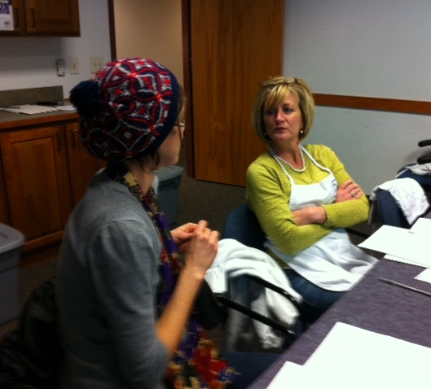
Debrief
Facilitator
Culinary
Instructor
Nutrition
Instructor
What went well?
What could have been better?
What resources do we need?
How can we incorporate the suggestions for next week?
ADULTS
Notes:
Once the participants have left, it may be tempting for the teaching team to leave immediately as well. Spending just 10 minutes together as a teaching team after class, however, is crucial for encouraging one another and working together to make the class successful in the coming weeks.
The facilitator should bring together all instructors and assistants and open the floor for discussion with questions such as “What went well today?” “What could we have done better?” and “What additional resources could I support you with to make the class smoother in the future?” If there were any participants who needed extra help, materials you were missing, or other concerns, now is the time to bring them up. The facilitator should make sure everyone’s voice is heard and that challenges are approached as a team instead of using the time to blame individuals or complain.
Culinary and nutrition instructors should be encouraged to share their thoughts with the team and suggestions on what would help them prepare for the next class. Now is also a great time for the team to identify certain activities and handouts that would be helpful for Lesson 2.
The facilitator should take notes during this discussion and assign action steps to certain team members if needed, so that all team members have a clear idea of their responsibilities after the debrief.
Congratulate each other! You have just completed your first week of Cooking Matters for Adults!

