Slide 1
Module Two:
Safe Cooking with Confidence
Goal: Encourage providers to safely prepare more home-cooked meals for the children in their care
Notes:
After your team has navigated Lesson 1, you will be more familiar with the pattern and flow of the lesson plans, making the following lessons easier to coordinate. Lesson 2 helps the participants learn about the benefits of home-cooking as well as strategies to select more of these options in their daily food choices.
Even though this is not your first week, it’s recommended that the facilitator, instructors, and assistants still arrive 30 minutes prior to class to help set up and talk about the flow of class. Spend at least 5 to 10 minutes talking about roles and how you will coordinate timing for today’s lesson.

Slide 2
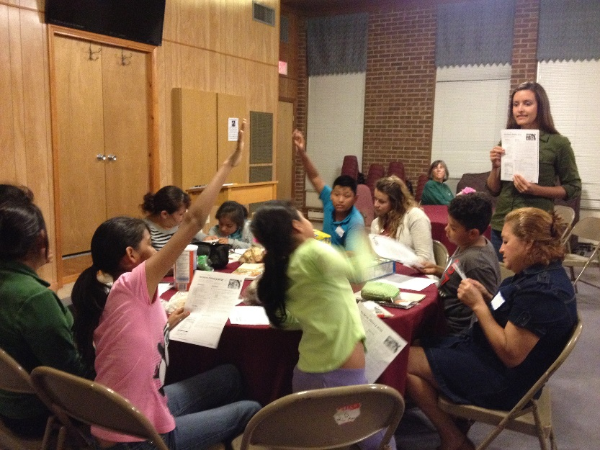
Introduction
Facilitator
Review
Open discussion to see what they remember
After hearing comments, sum up last week’s theme
Ask how the weekly challenge went
Introduce the new lesson
Start with questions to get the participants involved
Share theme
Explain flow of class
Notes:
Welcome the group and engage them in a conversation reviewing last module’s topic.
If you have any last minute additions to your roll or you want to reinforce the structure of the class, feel free to go over the typical flow of the modules.
After reviewing the past lesson, transition to the topic of the module for that day.

Slide 3
Module 2 Slideshow
Nutrition
Instructor
Slide one: Ask why food safety should be a top priority
Slide two: Highlight the immune system characteristics of children 5 and under
Slide three: Explain that food safety reduces risk with just a few steps and pass out Keeping Food Safe handout
Slide four: Review hand washing
Slide five: If time permits, conduct the cross-contamination demonstration
Slide six: Discuss cleaning solutions and state regulations
Slide seven: Discuss relationship between time and temperature for food storage
Slide eight: Review physical safety boundaries for caretaker kitchens
Slide nine: Culinary instructor facilitates dialogue about cooking likes, dislikes, and strategy
Notes:
These slideshow notes are in your Instructor Guide, but we will review them briefly now.

Slide 4
Cooking & Food Safety
Culinary
Instructor
Reinforce food safety
Review hand washing and knife safety
Creating Connections
Discuss recipes as frameworks
Discuss modifying recipes to make them less expensive
Discuss time-saving techniques and pass out Cook It Up Quick handout
Highlight kid-friendly steps in the recipe
Notes:
Delegate tasks and cook together, following the tips in your instructor guide for topics of conversation to go over as you cook. Be sure to discuss how to modify recipes to save money, time, and to engage kids in age-appropriate cooking activities.

Slide 5
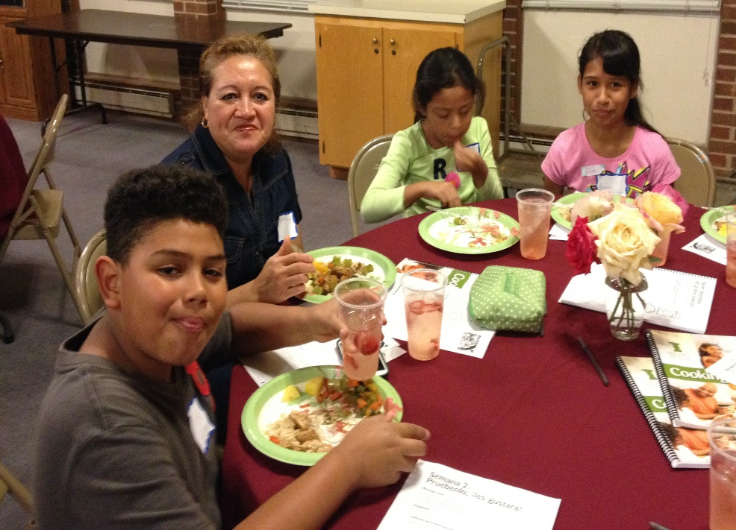
Eating Together
Facilitator
Have participants summarize food safety tips
Ask participants what skills they feel better about after class
Have participants complete the Set Goals: Safe Cooking with Confidence worksheet
Notes:
While everyone is eating together, the facilitator should engage the group in conversation, following the suggestions laid out in the instructor guide.
The facilitator should end the class by summarizing the key messages and introducing the weekly challenge. After listening to their goals, the facilitator should invite the participants to help clean up, delegating tasks as necessary.
Don’t forget to spend 5 to 10 minutes debriefing as a teaching team. Be sure to talk about what went well, what to improve on, and how to prepare for next week before heading your separate ways.

