Slide 1
Cooking Matters for Child Care Professionals
Gleaners Community Food Bank

Slide 2
Introductions
Name
In-home or center-based
Age group
What are you hoping take away from this training?
Notes:
Who: Coordinator
Full-group share for smaller classes (12 and under), turn-and-talk or pair-share for larger classes (15 plus)
Use big paper to record “What I Want to Learn”

Slide 3
Overview: Part I
Creating Positive Mealtime Attitudes
Safe Cooking with Confidence
Choosing Healthy Foods for Kids
*Part II: next Saturday, 9 am – 2:30pm
Notes:
Who: Coordinator

Slide 4
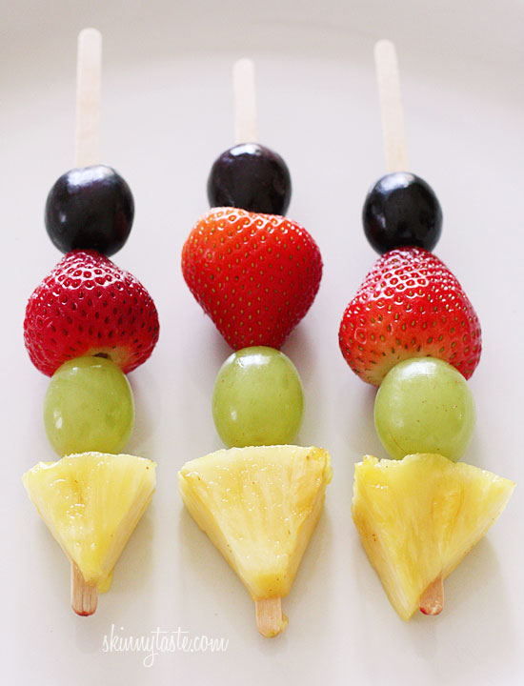
Snacks in a Snap (p. 2)
Smoothies
Avocado Crunch
Fruit Kebabs
Cucumber Sammies
Banana Pudding in a Bag
Notes:
Before class TO DO (Chef Educator):
Cucumber Sammies – Slice cucumber, cheese, and turkey and arrange in an assembly-line with picture-sequence cards; participants will arrange their sammies buffet-style
Banana pudding in a bag – Arrange ingredients in an assembly-line (use the sequence cards for ingredients/recipe steps); participants will arrange their pudding buffet-style
Fruit Kebabs - Chop fruit and cheese and arrange on platter with mini-tongs. Participants will self-assemble with skewers. Put out napkins.
Share: For snack, we will be preparing (read slide), all on pg. 2 of your spiral notebooks. These recipes are meant to be examples of cooking activities that can be done in the classroom. For Banana Pudding in a Bag and Cucumber Sammies, we will be using sequence/picture cards, instead of a recipe. As you’re preparing snack, be thinking about how you could translate it in your center or home – we’ll be doing a brainstorming activity in small-groups afterward.
(Coordinator to lead post-snack brainstorming activity).

Slide 5
Module 1: Creating Positive Mealtime Attitudes
Cooking Matters EXTRA for Center-Based
Child Care Professionals

Slide 6
Architecture of the Brain
Not only genetics, but also early experiences and interactions influence brain development
Notes:
Share: You have the opportunity to improve children’s eating habits and lifelong health because you interact with them daily. Positive early childhood experiences surrounding food and the social environment are critical for shaping healthy eating behaviors later in life.
We are going to discuss strategies that support positive experiences and environments surrounding food for the children in your care.

Slide 7
Promoting Healthy Eating Habits
Rituals
Modeling
Division of Responsibility
Language
Family-Style Dining
Stages of Feeding
Food Neophobia vs. Picky Eating
Notes:
These are some practices we’ll be talking about for promoting healthy eating habits (don’t need to read off list)

Slide 8
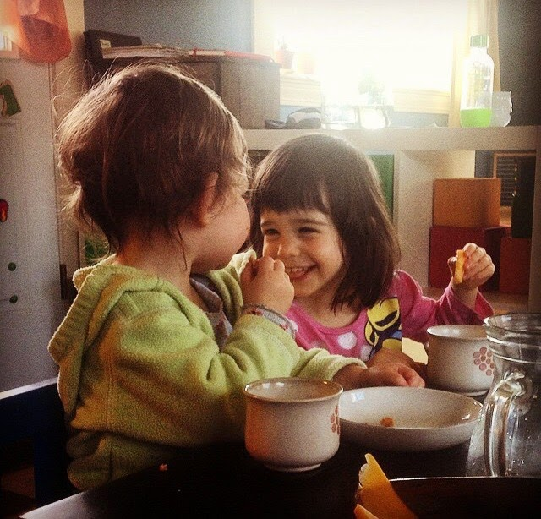
Rituals vs. Routines
Emotional value
Symbolic
Creative
Feelings and memories
Strengthen personal bonds
Create a sense of belonging
Remind people of their ties to history and tradition
Reinforce shared values
Notes:
Ask: Is this a ritual or a routine? “Every morning I get up and brush my teeth…. do you think that positive emotions and a sense of belonging are happening?” Answer: No, it’s just a routine. Ask: “Can the routine of tooth brushing be made a ritual in a classroom setting? How?” Share: Yes, make in meaningful, do it as a group, sing a song, etc.)
Share: Rituals are meaningful, they have emotional value. Use rituals as a way to create positive emotions and experiences around mealtimes to encourage positive relationships with food and healthy eating patterns.
Share: We are going to do an activity to brainstorm how we can create rituals within different mealtime activities.
To Do: Ritual Brainstorming Activity

Slide 9
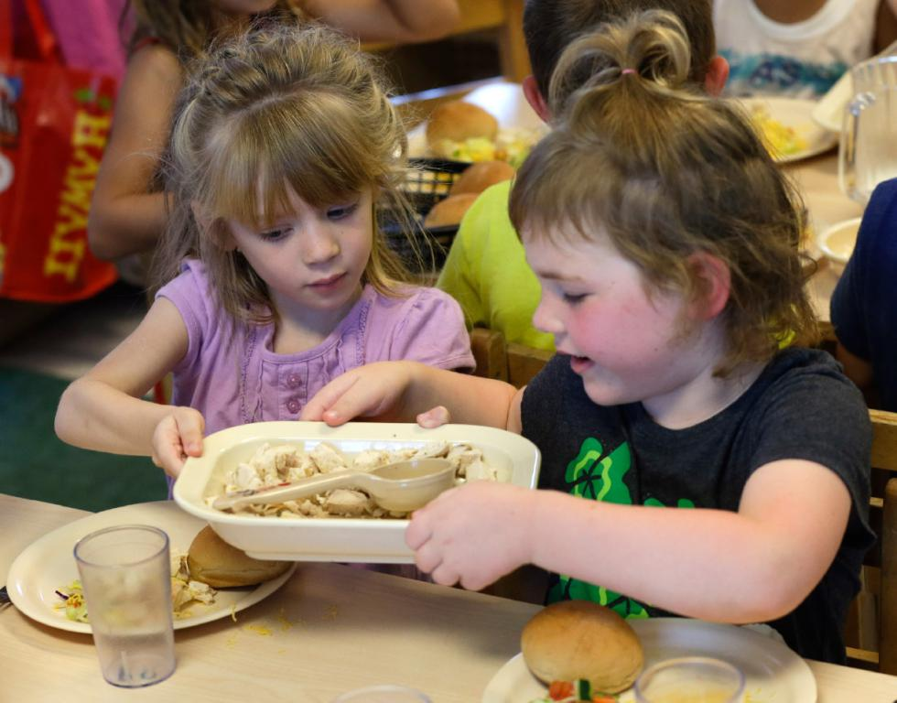
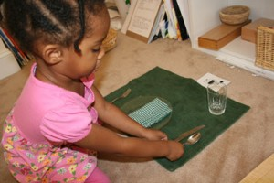
Notes:
Share: Here are some photos that show different examples of mealtime rituals. They don’t all have to be food related (for example, creating centerpieces or placemats).

Slide 10
Ritual Brain Storming Activity
How can the rituals you share lead to healthy food habits and positive mealtime behaviors?
Notes:
Ask: How can the rituals you shared lead to healthy food habits and positive mealtime behaviors?
Share: Children learn to…
Appreciate new foods by engaging in the mealtime process
Make healthy choices and figure out how much to eat
Eat meals and snacks at set times, rather than grazing throughout the day
Cooperation and responsibility by contributing to mealtime tasks
Value of eating together and engaging in meaningful interactions

Slide 11
Feeding Kids Well Takes Teamwork!
A new teacher started sitting at Amy’s meal table this week.
She believes that all children must take and eat at least 3 bites of everything before they can leave the table.
The former teacher let the kids decide what to serve themselves and eat.
What is Amy thinking or feeling now?

Slide 12
Feeding Kids Well Takes Teamwork!
The children in this classroom are learning that fruits and vegetables make great snacks.
Every day this week, the afternoon snack has been milk and graham crackers.
What message are the kids getting?

Slide 13
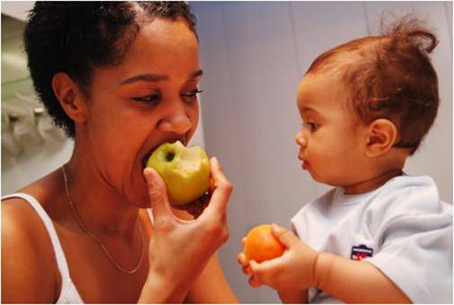
Set a Healthy Example
Eat meals and snacks together
Serve foods family-style
Be patient
Use encouraging words
Notes:
Ask: Do you sit and share meals with the children in your care? Why or why not? Why is this important?
Share: It gives you the opportunity to teach and model healthy eating behaviors, such as: How to use serving utensils, appropriate portion sizes and pacing, socializing, eating a variety of healthy foods, etc. It also gives you the opportunity to make mealtimes a pleasant, social experience, and facilitate discussion among children (or narrate, for the younger ones).
Positive role modeling correlates with an increased interest in food and less food fussiness among children. A child is more likely to try a food if he or she observes an adult enjoying it.
Ask: What are some other ways adults can model positive behaviors or attitudes? Poor behaviors or attitudes?

Slide 14
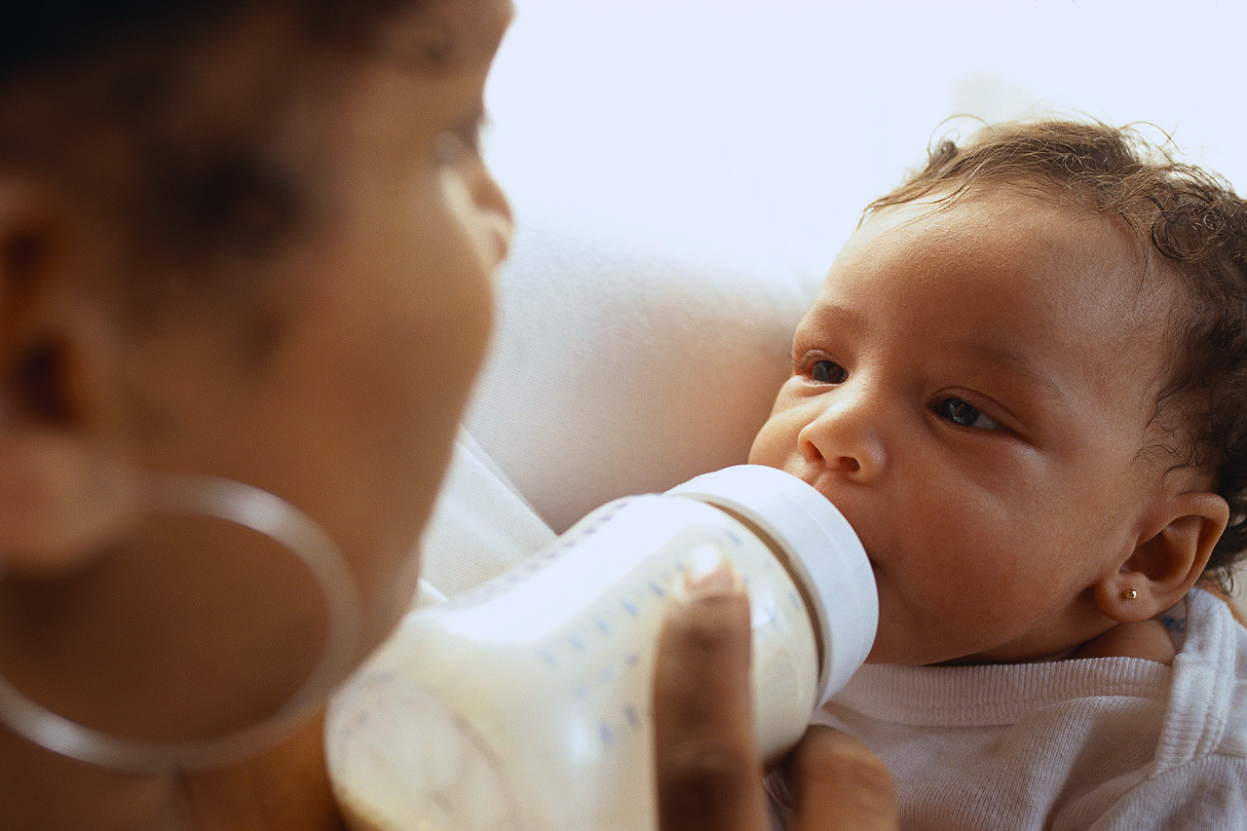
Stages of Feeding: Infant
Amazing Progress in Year One:
Moves from a milk-based diet to table food
What message does an infant get if she’s hungry and no one feeds her?
…or if she’s full but caregivers keep shoving the nipple into her mouth and try to get her to eat more?
Not all older infants want to be fed! Stand back and enjoy the show! (But keep them safe.)

Slide 15
Stages of Feeding: Toddler
Fill in the blanks:
A toddler’s favorite word is _ _.
What’s required now:
PATIENCE
PERSISTENCE (keep offering new foods—it may take 10-15 exposures before she’ll eat them!)
LIMITS on panhandling, poor behavior at the table
THE RIGHT TOOLS for self-feeding
Ideas for making turkey & cheese tacos more toddler-friendly?

Slide 16
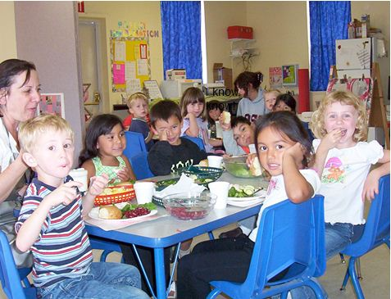
Stages of Feeding: Preschooler
What happens when you seat a kid who won’t eat salad between 2 kids who LOVE salad?
Industrious preschoolers like cooking and helping with meal time chores!

Slide 17
Stages of Feeding: School-Aged Child
In your experience:
What are their friends eating?
What food advertisements are they seeing on television?
How much time do they spend engaged in physical activity?
These kids can often buy their own food – help them learn to make good choices!

Slide 18
Food Neophobia
Developmental phase (18-24 months to 6 years)
Food neophobia vs. picky eating
Exposure → Familiarity → Intake → Preference
Familiarity can take up to 10-20 exposures… be persistent!
Exploring and exposure looks like
Smelling, listening
Feeling, poking, holding, shaking
Licking, nibbling, spitting out, tasting
Notes:
Don’t need to read slide, just notes below:
Share: Food neophobia is the rejection of new, unfamiliar foods (while picky eating is the rejection of familiar foods)
As a protective factor, humans have a predisposition towards sweet and salty and away from bitter and sour – this predisposition can be modified through experience and exposure!!!
The acceptance of new foods is a slow process, but persistence is essential; it is important to continue introducing a variety of foods throughout early childhood – the variety of foods they accept is actually greater now (2-5 y.) than in later childhood. Children establish food preferences and dietary habits through age 6.

Slide 19
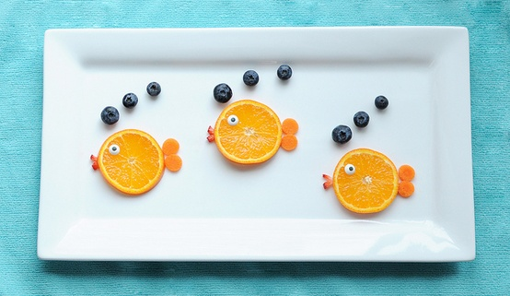
Overcoming Food Neophobia
Make food fun!
Keep offering the same food in different ways
Consistent, positive role modeling
Allow choices and autonomy
Teach and learn about new foods
Offer one new food at a time
No pressure
Notes:
Share: Here is a list of tips for overcoming food neophobia.
Ask: Have any of these tips worked well for you in introducing new foods?
How can we offer the same food in three different ways, for example with carrots (or choose another food)? Ex. Steamed carrots with butter/olive oil and seasoning, carrot sticks with hummus or peanut butter, mashed carrots (like mashed potatoes)

Slide 20
Want Kids to Reach for Healthy Foods?
Place healthy foods in reach!
Make sure they watch YOU reach for healthy foods
Allow kids to learn by choosing for themselves which foods to take and how much to eat
Notes:
Offer healthy options so children can learn to make healthy choices!!!

Slide 21
Questions?
Page 9
Notes:
Share: Turn to page 30 and take a few minutes to jot down notes on the review and reflection page

Slide 22
Turkey Tacos
Knife Safety
Measure Up
Talk like a Chef
Recipe – page 54
Notes:
Who: Chef Educator
Share: All recipes prepared today can be found in your CMCCP participant guide
To Do: Start hands-on cooking with knife skills/safety demo

Slide 23
Turkey Tacos
Do you think a child would find this recipe appealing?
What colors, shapes, or textures could be used to make it more appealing?
How could you serve this dish to make it fun for kids?
How could you involve kids in making this recipe?
Recipes are a framework that can be adjusted. What modifications would you make to this dish?
Notes:
Discussion prompts while we are eating lunch

Slide 24
LUNCH – 30 minutes

Slide 25
Module 2: Safe Cooking with Confidence
Cooking Matters for Child Care Professionals

Slide 26
Why Should Food Safety be a Priority for You?
Infants and young children are at a greater risk for foodborne illness
Notes:
I-7
Share: Children under 5 are highly susceptible to foodborne illness because their immune systems are not fully developed. This makes it extremely important to practice safe food handling. You can refer to Pg. 12 in your books, “Keeping Food Safe”

Slide 27
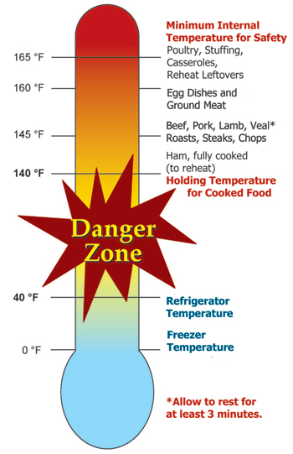
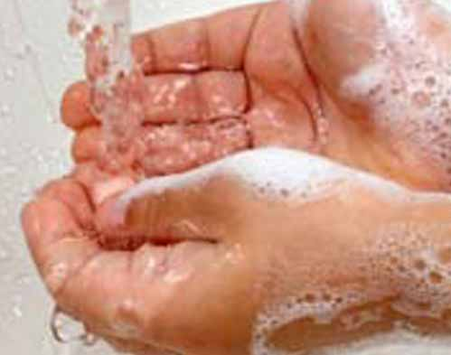
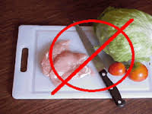
Prevent Food Contamination
Follow these three basic principles:
Keep foods out of the “danger zone”
Practice good hygiene
Avoid cross-contamination

Slide 28
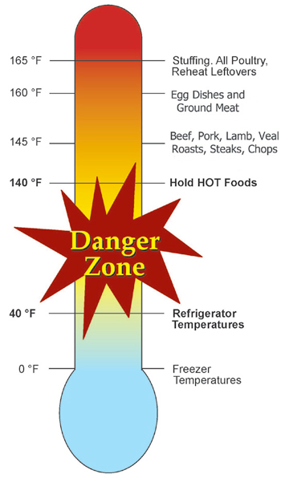
Keep Foods Out of the Danger Zone
Store, cook, and hold foods at safe temperatures
Keep hot foods hot
Keep cold foods cold
Use tools to check the internal temperatures

Slide 29
Practice Good Hygiene
Wash your hands
Wash children’s hands
Wash often with soap and warm water
for at least 20 seconds

Slide 30
Avoid Cross-Contamination
Wash cutting boards, dishes, utensils, and work surfaces before and after food preparation
Use separate cutting boards and work surfaces for raw meats and produce
Place cooked food on a clean plate
Disinfect serving areas

Slide 31
Avoid Cross-Contamination (cont.)
Sanitize* | Disinfect*
To soak, clean in a chlorine solution of 1 Tablespoon of household chlorine bleach mixed with one gallon of water | To wipe, clean surfaces with a stronger chlorine solution of l/4 cup household chlorine bleach mixed with one gallon of cool water
*These are solution guidelines; be sure to follow the requirements set by your local health department.

Slide 32
Use Ingredient List on Label to Identify Allergens (Pg. 14)
Notes:
Ask Does anyone have children in their centers with food allergies? What substitutions do you make? What precautions do you take in the kitchen?

Slide 33
Before you Begin Cooking…
What order should these steps go in?
Prep all of the ingredients so they are ready to be used in the recipe
Note the required and optional ingredients
Review the recipe steps once more before you begin
Read the recipe from start to finish, twice!
Gather all of the ingredients, cooking equipment, and serving dishes you need
Notes:
Ask: What order should these steps go in? (correct order on next slide)

Slide 34
Before you Begin Cooking…
What order should these steps go in?
Read the recipe from start to finish, twice!
Note the required and optional ingredients
Gather all of the ingredients and cooking equipment you need
Prep all of the ingredients so they are ready to be used in the recipe
Review the recipe steps once more before you begin
Notes:
I-9
Ask: What do you enjoy most about cooking? What do you enjoy least?
Why is it important to read the recipe in advance? Prepping ingredients before cooking?
I-10
Share: Pg. 18 in your books show time-saving strategies. Reserving food that has already been offered is not allowed in CACFP, but foods can be prepared, divided, safely stored, and served later.

Slide 35
Salmon Pasta Bake
Do you think a child would find this recipe appealing?
What colors, shapes, or textures could be used to make it more appealing?
How could you serve this dish to make it fun for kids?
How could you involve kids in making this recipe?
Recipes are a framework that can be adjusted. What modifications would you make to this dish?
Notes:
Discussion prompts while we are eating lunch

Slide 36
Questions? Goal Setting
Page 19
Notes:
Share: Turn to page 9 of your books and take a few minutes for reflection and goal setting

Slide 37
Module 3: Choosing Healthy Foods for Kids
Cooking Matters for Child Care Professionals
Notes:
I-13
Share: We will introduce several tools that can be used to support food choices

Slide 38
CACFP: Child and Adult Care Food Program (Pg. 22)
A program of the US Department of Agriculture (USDA)
Provides reimbursement for meals and snacks that meet requirements
Helps pay some of the cost of feeding children in child care
Ensures children get the healthy foods and nutrients they need
Notes:
I-13
Share: You can find CACFP Meal Patterns on pg. 22-24 in your books.
I-15
Ask: Looking at the meal patterns in your book, what do you notice about the portion sizes for each meal component? Do they seem large or small?
Share:
- Serving sizes are minimum amount required (no maximum)
- They are categorized by age and breakfast vs. snack vs. lunch/supper
- When meal planning, use the amount required for the oldest child as a guide for planning the appropriate total amount of food to prepare

Slide 39
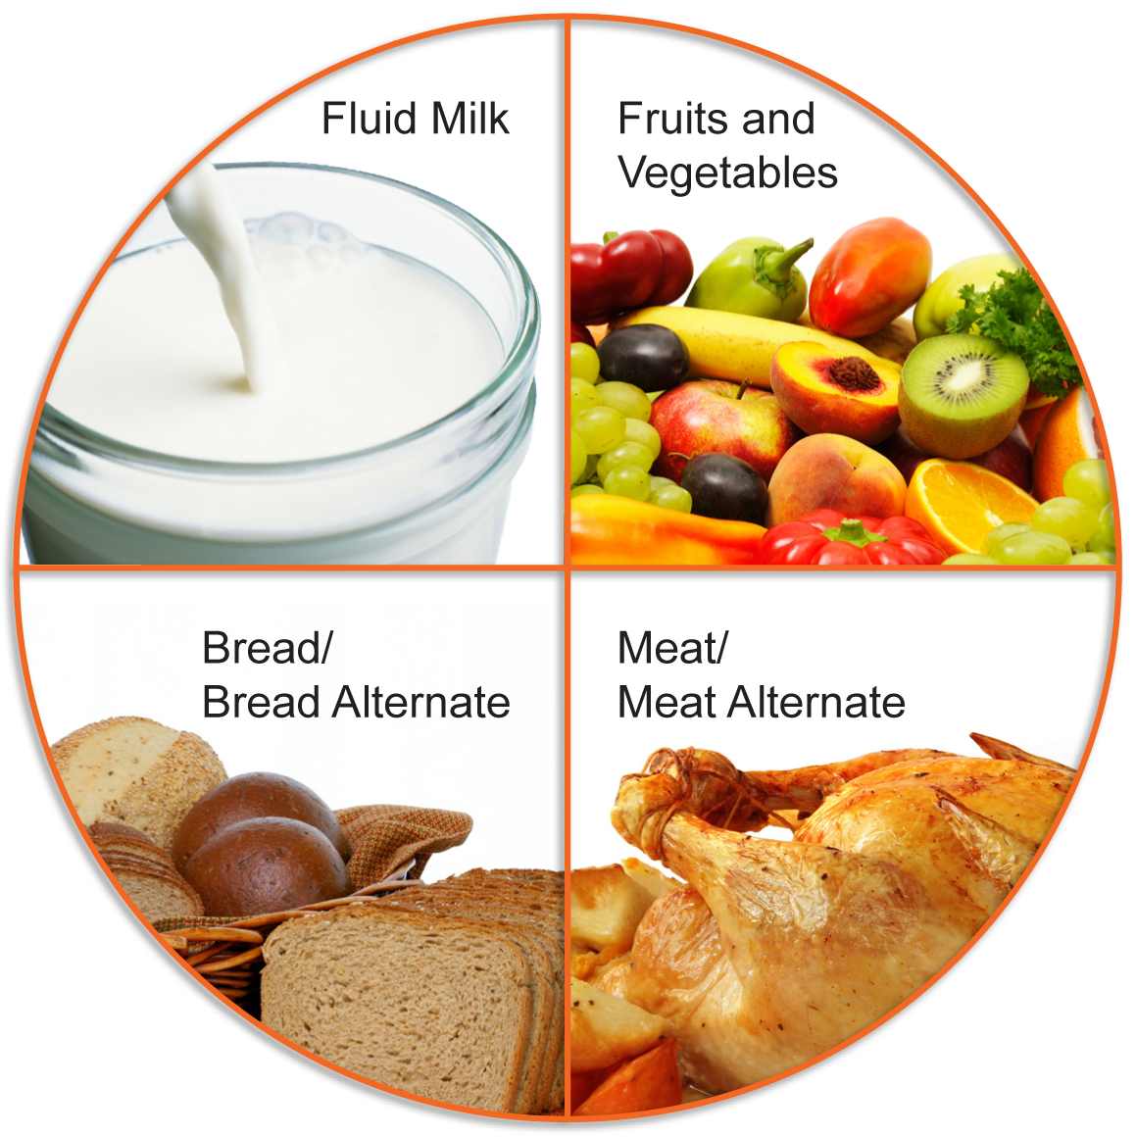
CACFP Meal Components
Notes:
I-14
Share:
Fluid Milk – Does not include cheese or yogurt. Does not count in powdered form, or if part of recipe
F/V – Can be fresh, frozen, canned, or dried. Includes starchy vegetables (ie. Potato, yucca, turnips)
Bread/Bread Alt. – Includes grains such as rice, bulgur, cereal, pasta, crackers, cornmeal. Does not include popcorn, potatoes, or hominy.
Meat/Meat Alt. – Includes fish, eggs, beans, nuts and seeds or their spreads, and dairy other than fluid milk. Now includes tofu.
*Beans can count toward Meat or Veggie, but not both.

Slide 40
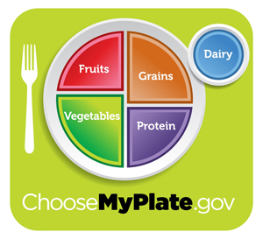
MyPlate (Pg. 26)
Notes:
I-15
Share: You can see MyPlate on Pg. 26 in your books
Ask: How many of you are familiar of MyPlate?
Share: MyPlate is the successor of the Food Pyramid. It is not meant to be an exact replica of our plate, but rather a symbol that can help remind us how to build a healthy diet
Ask: What do you notice about the way food is served on MyPlate?
Share: ½ fruits & veggies; ¼ grains and ¼ protein
Ask: How does this compare to the way you usually serve your plate? What does MyPlate tell us about which food groups should form the base of our diet? Which food groups should we eat from in smaller amounts?
Ask: How can MyPlate help you think about making healthy choices when you’re serving a mixed dish like pizza or quesadillas?
Break down a dish like pizza into food groups. Then, have them suggest ideas for adjusting ingredients to follow MyPlate themes, like topping the pizza with lots of veggies and smaller amounts of proteins and dairy, and using a whole wheat crust.
I-16
Share:
Grains – MyPlate recommends that half of your grains are whole, in order to consume enough fiber. We will discuss how to identify whole grains.
F/V – Half of your diet should be a variety of fruits and veggies. See pg. 27 in your book for some ideas.
Dairy – Low-fat and skim is recommended for children over two. Also look for low-fat varieties of cheese, yogurt, etc.
Meat – Lean meat and plant-based protein options.

Slide 41
MyPlate vs. CACFP
Notes:
I-16
Share: MyPlate is not the basis for CACFP. If participating, you should defer to CACFP meal patterns to ensure reimbursement. MyPlate can be a teaching tool for kids and families – and a guide for making healthier choices among CACFP creditable foods.
For example. CACFP allows both whole grain and enriched grain products in the Grain/Grain Alternate group, but MyPlate recommends that we should make half of our grains whole.
Ask: Any other examples?

Slide 42
The Nutrition Facts Panel
Notes:
I-17
Share: A handout on reading food labels in on pg. 28 of your books
Ask: Looking at the nutrition facts panel, which information do you already use? Serving size is the first thing you should look at. Why?
Share:
The serving size is the amount of food that the rest of the facts on the panel are based on. Ask yourself, “how many servings am I eating?” and multiply or divide the rest of the information as needed.
%DV tells us whether a food is high or low in a nutrient: 20% or more is high; 5% or less is low
Ask: Which nutrients do we want less of? Which do we want more of?
Share: The Nutrition Facts Panel can help to identify foods that are lower in fat, sugar, and sodium, and higher in fiber and other key nutrients.
We will work with nutrition facts more closely during Cooking Matters at the Store.

Slide 43
Why is it important to eat a variety of fruits and vegetables?

Slide 44
What is a Whole Grain?
Notes:
I-17
Ask: What is the difference between a whole grain and a refined grain?
Share: Whole grains provide a variety of nutrients that help keep our bodies healthy. When grains are refined, many important nutrients are removed, most importantly, fiber.
To Do: Putting Whole Grains to the Test. Soak a piece of whole wheat bread and enriched bread in two different bowls of water (about 5-10 seconds each). Gently squeeze out each piece of bread and show participants the difference. The whole wheat bread should look like a wet sponge, while the white bread should look more like wet playdough.
Share: (as you’re putting the bread in the water) The water represents your digestive system and this activity can demonstrate how whole vs. refined grains break down in your body
Ask: (after you squeeze out the bread and show it) What do you notice about the refined vs. the whole wheat bread? What does this mean for your body when you digest one vs. the other?
Share: The fiber is what is keeping the whole wheat bread together. The fiber in whole wheat bread means that it breaks down in your body slower, keeps you full longer, helps regulate your blood sugar, and is good for digestive health.
To Do: Pass out fiber tubes to demonstrate how much fiber is in different grain (and legume) products
Share: There is a handout about identifying whole grains on Pg. 29 of your books
Ask: How can you use labels to determine whether a grain is a whole grain? (use Pg. 29 as a reference)
Share: You should see the word whole in the first ingredient, such as whole grain wheat. The only exceptions are brown rice OR grains that aren’t available refined, such as bulgur, buckwheat, millet, oatmeal, and quinoa.
To Do: Pass out grain packaging and have participants work in groups to determine whether their package/product is a whole grain or not.

Slide 45
Whole Grain Examples
Whole Wheat
Bulgur
Brown rice
Oats
Whole corn (not de-germinated)
Quinoa
Buckwheat
Amaranth
Teff
Whole or hulled barley
Whole kamut
Millet
Sorghum
Whole spelt
Triticale
Wild rice
Helpful Tip:
To identify if a product is a whole grain, check the ingredient list to see if the first ingredient says: WHOLE
Notes:
Share: Whole grains come in a ton of varieties between wheat, rice, oats, etc. See some on the list, as well as in the baggies that we’re passing around.
To Do: Pass out grain baggies for visuals

Slide 46
Know Your Fats
 | UNSATURATED | SATURATED | TRANS
Are these fats good for you? | YES Lower bad cholesterol Lower risk of heart disease and stroke Provides fats your body needs like omega-3 fatty acids | NO Raise your “bad” cholesterol (LDL) Raise your risk of heart disease and stroke | NO Raise your “bad” cholesterol Lower your “good” cholesterol (HDL) Raise your risk of heart disease and stroke
Which foods contain these fats? | Vegetable oils (canola, olive, sunflower) Avocados Peanut Butter Fatty Fish Many nuts and seeds | Many animal foods (fatty beef, poultry with skin, lard, cream, butter, cheese, and whole milk) Baked goods Fried foods Coconut Oil | Baked good such as: Pastries Pie crusts Biscuits Cookies Crackers Stick margarines shortenings
How much should you eat each day? | Most of the fat you eat should be unsaturated. | Limit the amount of saturated fats you eat each day | Avoid trans fat
Notes:
(Not in instructor guide or participant book)
Ask: Have you heard of “healthy” and “unhealthy” fats? What do you know about saturated fat? Trans fat? Unsaturated fat?
Share:
Unsaturated fats are the “healthy” fats because they lower your bad cholesterol and provide fats your body needs, such as omega-3 fatty acids. They come from plant sources – olive oil, avocado, nuts and seeds. Most of the fat you eat should be unsaturated.
Saturated fats come from animal sources – butter, dairy, meat, (and coconut!). Saturated fats raise your bad cholesterol and should be eaten in moderation.
Trans fats are man-made and come from hydrogenated oils. Not only do they raise your bad cholesterol, but they also lower your good cholesterol. It important to check the ingredients list, because you will not always see them listed on the nutrition facts panel. Avoid foods with the word hydrogenated in the ingredients list; that means it contains trans fats.
To Do: Show to pound of fat and artery model as visual aids. Pass around fat tubes to show how much fat is in different animal products, and demonstrate lean vs not lean proteins.

Slide 47
Nutrient Recommendations
No more than…
AGE | Calories | Fat Grams | Fat tsp | Sodium Miligram | Sodium tsp
2-3 | 1200 | 40 | 8 | 1000 | ~3/8
4-8 | 1500 | 50 | 10 | 1200 | ~1/2
9-13 | 1800 | 60 | 12 | 1500 | ~3/4
In a WHOLE day!
Notes:
(Not in instructor guide or participant book)
Ask: Do these nutrient suggestions surprise anyone? Do they look small or large?
Share: You can find calorie needs based on age above, and then use that to see daily amounts for each food group.
Handout (to pass out): MyPlate for Preschoolers. This shows daily amounts for each food group based on age, with a serving-size example. Great resource for parents/families in English and Spanish.

Slide 48
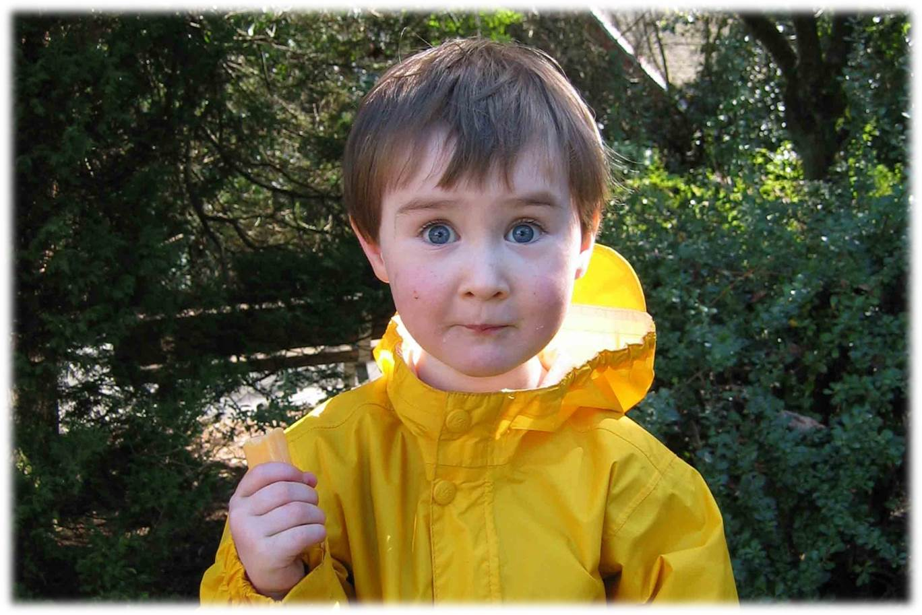
Questions?
p. 30
Notes:
Share: Turn to page 30 and take a few minutes to jot down notes on the review and reflection page

Slide 49
See you next Saturday!
Gleaners Community Food Bank

