Slide 1
Satellite Partner Training
Module 4: Course Coordinator Training, During and After Class
Notes:
Welcome to the last module in our Satellite Partner training. We will cover all the steps you need to take while class is going on and after it is over. After this module, you will have all the tools necessary to run your first Cooking Matters course.

Slide 2
Module 4 Contents
First Class
Ongoing Reporting
Last Class
After Class Reporting and Evaluation
Notes:
This training will cover several objectives. First, we’ll go over everything you’ll need to have on the first day. We will also cover our expectations as the class continues on the last day. After-class reporting is one of the most important steps of the entire satellite partner process.

Slide 3
First Class
Notes:
We’re going to begin with what you’ll need to prepare for the first day of class.

Slide 4
First Day Survey Administration
Participants Should…
Complete the waiver and pre-course e-survey
Coordinator Should…
Assure that the participants’ responses are confidential
Explain that contact information is requested to keep participants informed about events after the course is over – but it is not required
Zip code is REQUIRED
Notes:
Here are some details regarding first day paperwork.
Participants’ responses are confidential and will be combined with other participants’ responses to understand what everyone gained and how we can improve the program.
Contact information is requested to keep participants informed about events after the course is over, but is not required. Also, if the local or national Cooking Matters program seeks to do a follow-up study to track sustained behavior change, we might use the contact information to reach out. If participants are uncomfortable providing this information and would rather be anonymous, just have them leave the section blank, but request that they complete the demographic information.
The coordinator should read survey/enrollment questions aloud if needed to facilitate the process and assist with any literary challenges.

Slide 5
Closer Look: Demographic Information
There are a couple aspects of the e-survey demographic page regarding the Hispanic/Latino Ethnicity that some participants find a little confusing:
Questions are asked separately to comply with reporting requirements of federal funders (e.g. SNAP-ed)
Participants should answer both questions
Notes:
Let’s review a few questions on the enrollment form which some participants find tricky. The Hispanic/Latino Ethnicity and Race questions can be a little confusing to participants, especially those that identify as Hispanic or Latino.
These questions are asked separately to correspond to the way the census tracks ethnic and racial backgrounds and to comply with the reporting requirements of many large government funders of Cooking Matters programs such as SNAP-ed.
Each participant should answer BOTH questions. For the Hispanic/Latino ETHNICITY question all participants should choose ONE response, Yes or No. For the RACE question, participants can choose AS MANY THAT APPLY. For example, a Cuban-American may identify ethnically as Hispanic/Latino, and racially as Black or African American.
If participants do not answer both questions, you should perform a visual assessment and answer the questions for them after the course is over. This is especially important if your organization receives SNAP-ed funding.

Slide 6
Closer Look: Demographic Information
Another part that can be confusing is providing the number of people in their household.
Can be confusing to participants living in a shelter or transitional living facility
Refers to family members and dependents living in the same house as the participant
Intention is to understand the number of people who will be affected by participating with Cooking Matters
Notes:
Another question that can be confusing for participants is providing the number of people in their household. This number refers to the number of family members or dependents living in the same house with the participant counting him or herself. If participants live in a shelter or transitional center, please ask them to count only themselves and their dependents, not everyone living with them in the shelter or transitional center.
Keep in mind that the intention of this question is to assess the number of people who will be affected by the participants’ experience with Cooking Matters.

Slide 7
Course Coordinator and Volunteer’s Roles
Volunteer’s first class responsibilities include:
Creating a welcoming atmosphere
Helping to lead introductions
Helping to set a code of conduct
Stressing attendance
Emphasizing kitchen safety
Keeping class running smoothly
Reviewing with volunteers after class
Notes:
For the duration of the course, the course coordinator should support and coach the volunteer team to lead the course successfully. In the first class, the coordinator may take a more hands-on approach to model a welcoming attitude for volunteers and to set expectations for participants. They should:
Remind volunteers that the first day of class is extremely important for developing a relationship with participants, and that volunteers should take time to get to know participants to build cohesion among the group.
Once class begins, the coordinator should introduce themselves and the volunteers.
They should set the expectation for participants that the volunteer team is to be respected at all times.
Ask volunteers to lead participant introductions, encouraging them to take their time and get to know everyone.
Continue to set expectations by leading, or asking the volunteers to lead, a class discussion on appropriate classroom behaviors (such as no outside food, silence cell phone, come to class on time, no badmouthing food, and trying at least one bite of each food or dish). With participants’ input and involvement, help create a code of conduct to which everyone agrees.
Write the code of conduct on flip chart/dry erase/sheet of paper and display it each week so it can be referenced as necessary.
As part of the code of conduct, or as a separate discussion, be sure to emphasize the importance of consistent attendance. Explain to participants that inconsistent attendance is a disruption for both participants and volunteers.
Be sure that plenty of time is spent in the first class setting expectations with participants about kitchen safety. Have volunteers lead the discussion on kitchen safety protocols. The coordinator should set an example for volunteers by gently but consistently reinforcing and correcting unsafe kitchen behaviors on day 1, and throughout the course as needed.
After introductions, the coordinator should make sure participants have filled out their paperwork, getting assistance from volunteers as needed. After that, it’s time to cook! Coordinators should guide volunteers and help keep the class running smoothly. After the class is over, the coordinator should lead a debrief discussion of the day, and then plan the next week’s lesson with the aid of the volunteers.
Volunteers play a huge role not only during the first class, but throughout the duration of the entire Cooking Matters course. It is imperative that they are constantly involved for the success of the course.

Slide 8
Ongoing Support
Notes:
Over the duration of your classes, the course coordinator has a variety of ongoing responsibilities.

Slide 9
Course Teams’ Role
The course team’s responsibilities throughout the course includes:
Troubleshooting and coaching
Helping to set an appropriate instruction plan
Providing support by relating to participants
Facilitating working together and team-teaching
Assisting in class with time management
Ensure Gold Standards are met
Documenting the course – taking pictures and listening for participant quotes
Notes:
In addition to setting expectations on day one, it is the coordinator’s role to support volunteers throughout the course as needed. The coordinator should be sure the volunteers understand that the coordinator is there to support them, so they feel comfortable providing feedback and are willing to accept any constructive criticism. Guide volunteers to follow course Gold Standards as needed. Perhaps the most fun task for a coordinator is taking pictures throughout the class and collecting quotes from participants. You can use these in your own materials and also send them on to the Food Shuttle. Some of their other responsibilities are listed on this slide, such as assisting the coordinator with time management, relating to and supporting the participants, and helping to follow the set instruction plan.

Slide 10
Last Class – Graduation!
Notes:
Next is the most exciting day of class – graduation!

Slide 11
Survey Administration
Key Action Steps:
Schedule at least 20 minutes to complete survey
Introduce survey: emphasize it is not a test; we want to gather information to improve future courses
Notes:
The coordinator needs to schedule plenty of time for the survey on the last day, especially if there is a translator working with the class. Emphasize the survey is not a test so they can be completely honest. The e-survey administration guides provides more tips, ideas, and scripts for communicating these instructions.

Slide 12
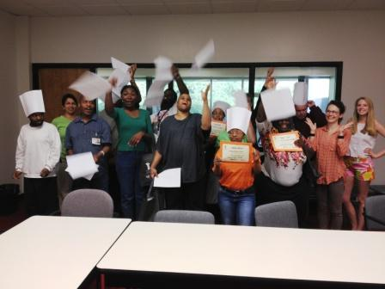
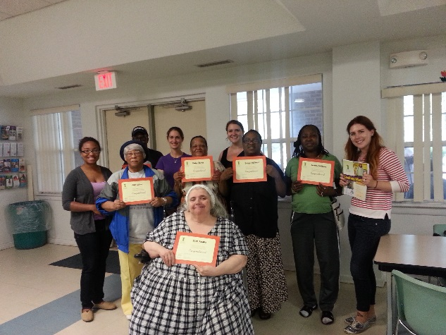
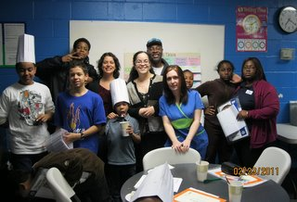
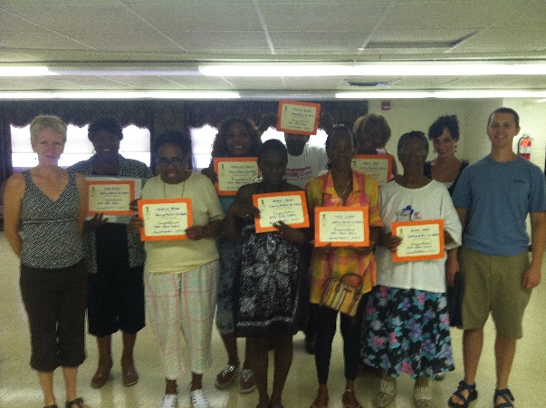
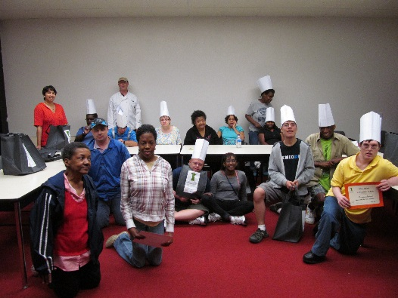
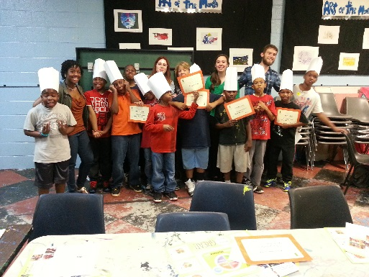
Graduation!
Make a favorite recipe
Hand out participant books
Trivia
Celebrate!
Notes:
Graduation is a joyous occasion for Cooking Matters. Give participants the time to feel proud of their accomplishment. Make a favorite recipe from earlier in the class or something special that participants have expressed an interest in. When it is time to hand out the certificates, make a big deal out of it! Today is the day that participants can bring home their workbooks, so be sure that no one forgets theirs. Remind them that there are many more recipes that what was covered in class to explore at home with their new skills!

Slide 13
Final Day Responsibilities
At the end of the course, it is essential to thank the team that made it all happen: your volunteers!
Conduct a short debrief to get feedback & to learn about volunteer’s experiences
Informing them about an upcoming email with a link to an online volunteer survey
Acknowledging your appreciation for their service
Notes:
At the end of the course, it is essential to thank the team that made it all happen: your volunteers! Make sure to get feedback from them to see how you can improve their future experiences and ensure they sign up for another course. Let them know that they will be sent an online survey in the next few weeks.

Slide 14
After Class
Notes:
Now that the class is over, there are a few final steps to take.

Slide 15
Course Close-Out
Complete and e-mail to cmsatellite@gcfb.org within one week of your last class date:
End of Course Reporting Form
Attendance Tracking Sheet
Start planning your next course!
Notes:
After you have completed the Staff-Only sections on participant paperwork, you should then fill out the End of Course Reporting Form, available on the Satellite Partner resource blog. This will give us all the information we need for our database as well as give you a chance to express final remarks about the course. When you have filled that out, make copies of your paperwork for future reference and backup in case of other problems. Send the materials listed here to GCFB within the week. Also email any pictures or quotes you have collected throughout the course. After that, it’s time to enjoy your success and start thinking about your next course.

Slide 16
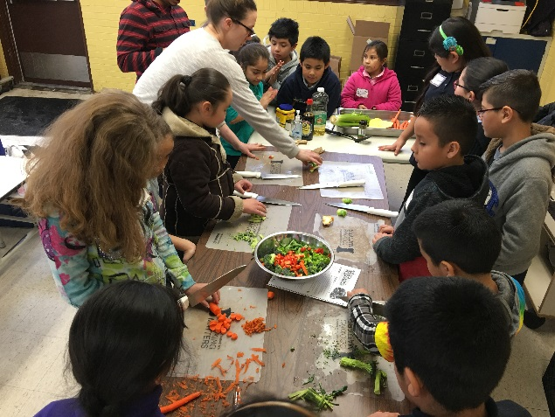
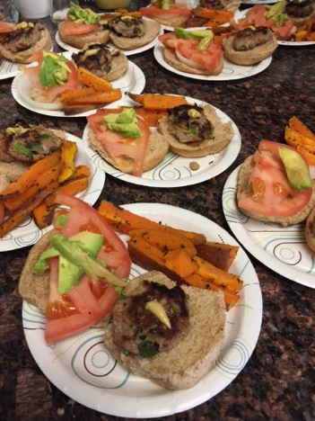
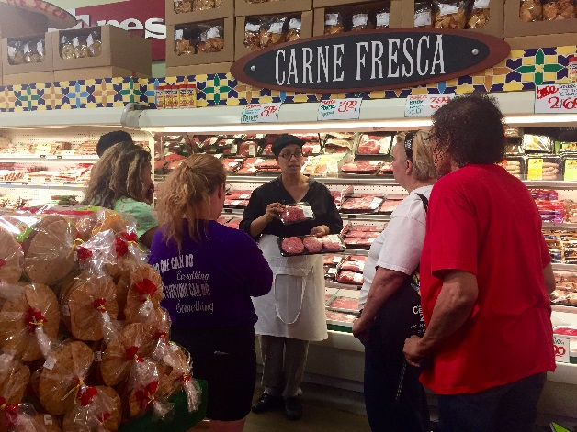
Thank You!
Notes:
You now have all the information, skills, and resources necessary to begin a Cooking Matters course. Thank you and good luck!

