Slide 1
Satellite Partner Training
Module 1: The Fundamentals of Cooking Matters
Notes:
Welcome to Module 1, the Fundamentals of Cooking Matters.

Slide 2
Module 1 Contents
Education Model
Cooking Matters Course Guidelines and Requirements
Gold Standards
Measuring and Communicating Impact
Notes:
In this Module, you will learn all about the education model that is the foundation of all Cooking Matters courses, the program’s guidelines and requirements, Cooking Matter’s Gold Standards, and how Share our Strength and Gleaners Community Food Bank measure and communicate the impact this program has on families, communities, and childhood hunger.

Slide 3
Education Model
Notes:
To begin, we will start with the learner-centered education model that is the cornerstone of every Cooking Matters course.

Slide 4
Pillars of Learner-Centered Courses
Hands-on
Team-taught
Use of facilitated dialogue
Notes:
Cooking Matters courses are not based on demonstration nor lecture; they are “participatory” and centered on the learner. The Learner Centered Model is integral to meeting ALL of the Gold Standards, which we will discuss in a moment.
Learner-Centered courses
Recognize that learners are 'experts' in their own lives,
Involve sharing and comparing of experiences from members of the group, and
Create a safe environment for learners to consider changing behaviors.
There are three specific techniques that course coordinators and volunteer instructors can use to make sure that programming is learner-centered; they can make sure courses are hands-on, taught by a team, and use facilitated dialogue methods.

Slide 5
Hands-on
Use of facilitated dialogue
Team-taught
Notes:
Now we’re going to focus on the effectiveness of Hands-On learning and educating.

Slide 6
Learner’s Ability to Retain Information
Research shows the average person retains…
20% of the information they hear,
30% of the information they see,
50% of the information they see and hear,
70% of the information they obtain through conversation,
And 90% of the information they obtain through doing a task.
Notes:
According to these statistics, the most effective method for a learner to retain information is through conversation and actually doing a task. Due to these numbers, Cooking Matters courses are highly participatory and encourage it’s participants to engage in constant dialogue and practice each task presented to them.

Slide 7
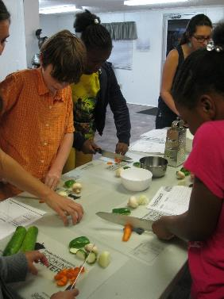
Effectiveness of Participatory Classes
“I’ve tried things that I never thought I was going to eat. I also know how to cook things, so when I go home I can help my mom with a lot.”
-Cooking Matters for
Teens Graduate
“I still prepare many of the meals that I learned in Cooking Matters. So much of what I learned in the class, I use in my day-to-day routine.”
-Cooking Matters for
Adults Graduate
Notes:
Cooking Matters’ design allows participants to learn while they cook, shop or participate in nutrition education activities, helping them retain the most information possible.
While you deliver food skills education through Cooking Matters, please ensure volunteers are not hosting all-demo or all-lecture courses or tours. Also make sure they allow participants to contribute to the education process by cooking and doing nutrition activities.

Slide 8
Hands-on
Use of facilitated dialogue
Team-taught
Notes:
Team teaching creates an engaging learning experience for both participants and instructors.

Slide 9
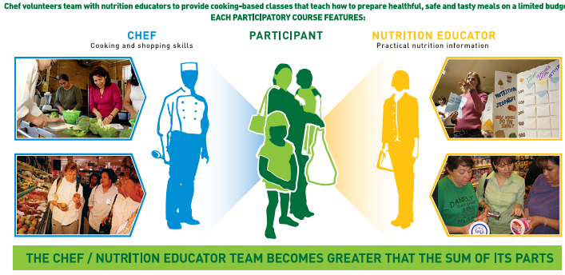
“Instructor interaction and collaboration directly impacts course quality.”
Process Evaluation of Cooking Matters National Nutrition Education Program, The Evaluation Center, Western Michigan University
Notes:
Cooking Matters courses are designed to be taught by two qualified instructors who share their professional expertise in cooking, nutrition, and resource management. Qualified chefs work with qualified nutrition professionals to build upon each other’s knowledge. They reinforce key messages from different perspectives. This creates a dynamic classroom setting.
You will learn more about how to recruit appropriate volunteers in our next training module.

Slide 10
Hands-on
Use of facilitated dialogue
Team-taught
Notes:
The third method used in Cooking Matters courses is a technique called Facilitated Dialogue.

Slide 11
What is Facilitated Dialogue?
Group teaching that involves active participation of both the learner and educator
Recognizes that learners are ‘experts’ in their own lives
Involves sharing & comparing of experiences from members of the group
Creates a safe environment for learners to consider changing behaviors
TOOLBOX
Shared Group Expectations
Bike Rack/Parking Lot
Open-Ended Questions
Pro/Con Charts
Menus & Choices
Notes:
Facilitated Dialogue is a method of group teaching that involves active participation of both the learner and the educator. It offers proven techniques for engaging learners. Each of Cooking Matters curricula’s weekly lessons have been adapted to incorporate Facilitated Dialogue techniques. The Facilitated Dialogue techniques and tools will be discussed in further slides.

Slide 12
Shared Group Expectations
Examples:
We will all come to class on time and ready to learn
We are here to support and listen to each other
We will not interrupt each other
…etc.
Purpose: creating an environment where all are encouraged to learn, participate, and if comfortable, share and learn from each other.
Notes:
The first technique in Facilitated Dialogue is the establishment of Shared Group Expectations. It is recommended that at the start of each Cooking Matters course, the group establish shared expectations for the course. Examples include the items on the slide.
What are some other expectations that would work in a Cooking Matters course? Attentive listening; no blaming or accusing; no forcing someone to speak; and respecting each other’s time, opinions and experiences. A favorite, especially in our kids classes, is “Don’t yuck someone else’s yum.” It promotes tolerance and trying new foods or previous disliked foods in new ways.
Establishing these expectations helps the group create an environment where all are encouraged to learn, contribute, participate, and if comfortable, share and learn from each other.

Slide 13
Bike Rack/Parking Lot
‘Park’ learners’ ideas and questions that aren’t quite aligned with the lesson or course objectives for a later time.
Notes:
A “Bike Rack” list can be used to ‘park’ learners’ ideas or objectives that aren’t quite aligned with a particular part of a lesson for a later time, either that same class or following classes. Consider physically writing these questions down, which is a technique that acknowledges learner ideas while creating a reminder for incorporating them at a more appropriate time.

Slide 14
Open-Ended Questions
Open-Ended Questions engage learners in discussion.
Example:
Do you like Open-Ended Questions?
vs.
How does it feel when you get a chance to have an open conversation about a topic?
Notes:
Open-Ended Questions engage learners in discussion. They:
Do not seek yes/no answers,
Aren't about right and wrong answers,
Help participants reflect and make the information personally relevant.
They also allow you to find out if the learner
Recognizes there is a problem,
Has any concerns about the issue, or
Has any intention to change.
Allow you to assess participants' confidence level for making a change
On this slide, you can see the difference between a yes or no question and one that is open-ended. The second allows for more dialogue on a topic.

Slide 15
Pro & Con Charts
Help the learner to see both sides of changing and not changing,
Allow learners to consider a range of ideas that might help them make changes, and
Help facilitators realize what will support or block the learners’ attempts to make changes
Notes:
Pro/Con Charts are another tool that encourages facilitated dialogue in class.
They help the learner to see both sides of changing and not changing,
allow learners to consider a range of ideas that might help them make changes, and
help the facilitators realize what will support or block the learners’ attempts to make changes.
A great example of a pro/con chart can be used with Whole Grains.

Slide 16
Whole Grains
Pros
Stay full longer
Lower cholesterol
Get tons of fiber to help digestion
Energy for the day
Cons
Different taste and consistency than white bread
Can be more expensive

Slide 17
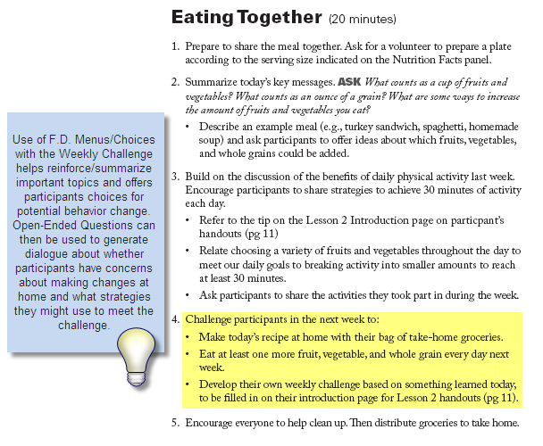
Menu and Choices
Instead of asking participants what change they will make, give them options to choose from. This technique is incorporated in the curricula, as seen in the “Eating Together” menu.
Notes:
Finally, Menus and Choices is another facilitated dialogue technique can be used to engage learners in discussion about potential behavior change. Instead of asking participants what change they will make, give them options to choose from. This will help them remember certain topics and will encourage discussion about potential concerns around making different changes. The slide features an example of how the Menus and Choices technique is incorporated in the curricula.
Using all of these techniques can be helpful not only to stimulate conversation, but to create a comfortable place to begin to make behavior changes.

Slide 18
Guidelines and Requirements
Notes:
Now we will review the guidelines and requirements for Cooking Matters programming.

Slide 19
Implementation Guidelines
Cooking Matters signature courses must:
Provide hands-on cooking
Promote interactive discussions & opportunities to practice new skills
Be led by a teaching team of one qualified culinary professional & one qualified nutrition professional
Be free of charge to eligible low-income participants
Include no fewer than eight and no more than 15 participants
Be offered to first-time graduates only
Occurs two hours per week for six weeks
Notes:
Please note that all partners are expected to adhere to these guidelines to ensure that Cooking Matters courses across the country provide a high-quality, effective learning experience for our participants.
Hands-on
All Cooking Matters courses must provide hands-on cooking. Courses are designed to be interactive with lots of opportunity for practice. This helps participants become comfortable making meaningful changes to the way they plan, purchase and prepare meals at home.
Free of Charge
Cooking Matters courses are intended for families and individuals living in low-income households. Participants must never be charged for courses.
Participant Count
To facilitate classroom management and program efficiency, we recommend that your courses have no fewer than 8 and no more than 15 participants. In CM for Families courses, eight child/adult pairs is the recommended maximum number of participants. If you cannot meet these numbers by the third class of the series, we recommend cancelling the course and rescheduling it for a time that guarantees higher attendance rates.
First-time Participants Only
Commonly participants love their Cooking Matters course so much that they want to take it again! However, Share Our Strength does not allow offering courses to participants that have previously graduated from that same course. If an eager participant would like to re-take the course, consider making that participant a class assistant, or organize another course for which they are eligible (such as Cooking Matters for Families).
Timeframe
Finally, our signature courses are designed to be offered over a period of 6 weeks, with participants meeting for a 2 hour class each week. There is some flexibility here, such as shorter classes over a longer time period or multiple classes per week.

Slide 20
Specific Requirements
In addition to the implementation guidelines for ALL Cooking Matters courses, we also have a few guidelines when offering specific courses.
Grocery Store Tour (including $10 Challenge Activity):
Cooking Matters for Adults
Take Home Groceries:
Cooking Matters for Adults
Cooking Matters for Families
Don’t forget to include a copy of the recipe!
Notes:
There are some guidelines for specific Cooking Matters courses.
Grocery Store Tours – all Cooking Matters for Adults must include a grocery store tour during the fifth lesson, which includes a $10 challenge activity as part of the tour. Share Our Strength believes these in-store activities provide a crucial opportunity for practical application of the knowledge and skills participants have learned throughout the course. While at the store, participants practice skills such as reading food labels, comparing unit prices, identifying whole grain products, and shopping the perimeter of the store to locate the healthiest foods. More detailed instructions for conducting the tours are found in the instructor guides for each course.
Take Home Groceries – in the Cooking Matters for Adults and Cooking Matters for Families classes, a requirement is to provide take-home groceries. Take-home groceries should enable participants to practice making at least one of the recipes taught in class. In general, send home all recipe ingredients except small quantity items that may be on-hand at home, such as cooking oil, butter, eggs, salt, pepper, and common herbs, spices, or condiments. To best use resources, re-package bulk items to provide participants with only the amount they will need to make the recipe. This is a great idea for spices especially.
Guidelines for take-home groceries should be followed at all times, though it is encouraged to make small adjustments if necessary to avoid waste. For example, if participants will not be able to refrigerate their groceries within an hour after class, it is acceptable to provide only the non-perishable ingredients to make the recipe. You are also encouraged to provide items at least once during teen courses so they can practice skills at home. At the Food Shuttle, we use the food available to us and make substitutions in class and with take-home groceries. This is a great lesson for participants to use what they have to adapt recipes.

Slide 21
Cooking Matters’ Gold Standards
Notes:
Next, will cover Course Gold Standards, which are the essential requirements for every course.

Slide 22
What are Gold Standards?
A set of six requirements for Cooking Matters courses.
Curricula (content and materials) is delivered.
Instructors use intended methods of content delivery.
Class reaches intended audience.
Coordinator manages/facilitates class and supports instructors.
Instructors demonstrate expertise in topic and competence leading class.
Positive learning environment is created and maintained.
Notes:
The Gold Standards are a set of requirements for Cooking Matters courses. It is a list that consists of 6 Gold Standard; each has a set of key behaviors and actions that, if followed, can help your courses be as meaningful as possible for course participants.
The Gold Standards are based on the Cooking Matters philosophy that learner-centered education has great impact and affects long-lasting behavior change.
Throughout this training, let’s keep these Gold Standards in mind as we walk through the essential information to help you to successfully coordinate courses.

Slide 23
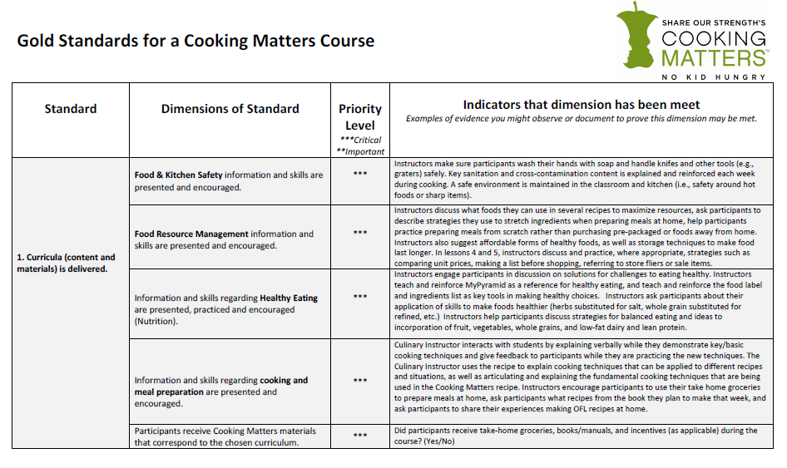
Notes:
This is a visual of the first page of the Cooking Matters Course Gold Standards. Each standard has a list of dimensions and indicators to help you to maintain Gold Standard courses. You can find this document on our Satellite Partner Resource Blog.
If all programs use this as a framework for courses, it ensures ALL Cooking Matters course participants have a positive learning experience and take improved nutrition practices, eating habits and food budgeting skills with them.
You will also notice that each dimension has a priority level, ranging from critical to important. Those that are listed as critical are essential; it would be ideal if those that are considered important are also upheld. Some of the dimensions are things that are second nature to you and the people you work with, and some may take more finesse to fine-tune.
I encourage you to become familiar with the Gold Standards. There is a simplified version of the Standards that you will share with your volunteers, which we will cover in the next module.

Slide 24
Measuring and Evaluating Impact
Notes:
Lastly, we will discuss about the national and local impact of teaching food skills, along with how Cooking Matters measures and communicates the impact it has on the community and childhood hunger.

Slide 25
National Reach
18 Reasons (CA)
Arkansas Hunger Relief Alliance (AR)
Capital Area Food Bank (DC)
Cornell Cooperative Extension (NY)
City Harvest (NY)
Community Health Network of CT Foundation (CT)
Cooking Matters Colorado (CO)
Cooking Matters Massachusetts (MA)
Dare to Care Food Bank (KY)
EverThrive Illinois (IL)
Filpany (FL)
Food Bank of South Jersey (NJ)
Foodlink, Inc (NY)
Georgia Coalition for Physical Activity and Nutrition (GA)
Gleaners Community Food Bank of Southeast Michigan (MI)
Good Shepard Food Bank (ME)
Idaho Food Bank (ID)
Inter-Faith Food Shuttle (NC)
Local Matters (OH)
Lowcountry Food Bank (SC)
New Hampshire Food Bank (NH)
North Texas Food Bank (TX)
Operation Food Search (MO)
Oregon Food Bank (OR)
Second Harvest Food Bank of Greater New Orleans and Acadiana (LA)
Second Harvest Food Bank of Lehigh Valley (PA)
Solid Ground (WA)
Tarrant Area Food Bank (TX)
The Queens Valley (NY)
University of Minnesota Extension (MN)
Virginia Cooperative Extension (VA)
Visiting Nurse Association (NE)
Notes:
These are the national organizations that partner with Share Our Strength to implement Cooking Matters six-week cooking courses and other food skills education.

Slide 26
National Impact
Signature Courses
- Since 1993
- 9,000+ courses
- More than 120,000 families helped
Cooking Matters at the Store
- Since 2010
- 1,700+ tours
- Almost 10,000 tour participants in 2012
Toolkits
- Since 2011
- Provides increased access to food skills education
Building Food Skills, Ending Hunger
Notes:
Since the program’s start, Cooking Matters signature courses have helped more than 120,000 families learn to get the most nutrition possible from budget-friendly meals. Hundreds of Cooking Matters at the Store tours have taken place since its inception in 2010, impacting thousands of families. Toolkits are also a relatively new tool that are being used to reach an ever-increasing audience.

Slide 27
Program Evaluation
Why does Share our Strength collect data to evaluate Cooking Matters programs?
… to learn:
If what we are doing is working
Who we are reaching
If we can prove that what we are doing works
How we can make programming better
How we can better spend our time and money
What our contribution is to ending childhood hunger
Notes:
First of all, why does Share Our Strength collect data to evaluate Cooking Matters programs? They, and we, want to assess all dimensions of classes. Who are we reaching? Are we reaching them effectively? How can we improve the program? How can we best use our resources? Are we actually ending childhood hunger? These are important questions to keep in mind even on a satellite partner level.

Slide 28
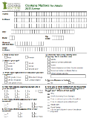
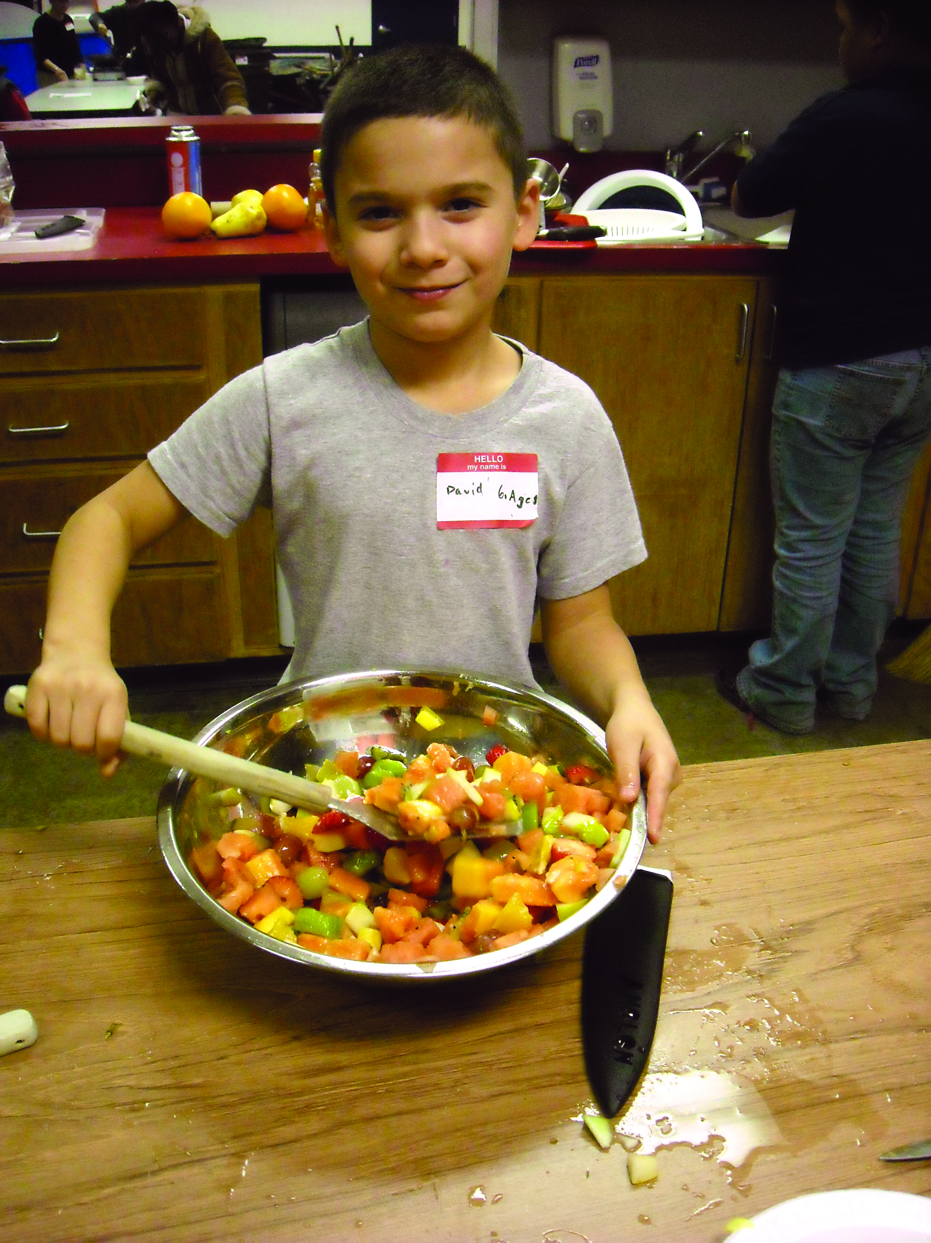
Measuring Impact
Outputs + Outcomes = IMPACT
Evaluation Tool: Surveys
Tracked by Lead Partners
& Share Our Strength
Outputs
Participant Surveys
Photos, videos, stories, quotes
Outcomes
Notes:
We access our impact on the community through combining the outputs and outcomes of Cooking Matters programming.
Outputs involve who we reach and how many people are reached.
Outcomes are the second component. They involve changing lives – how are participants’ lives different after taking part in a course? Outcomes include changes in knowledge, skills, self-efficacy, and attitude.
Impact is the sum of these two components. Our impact results in more families eating healthy food, improved food security, and a better food environment for children. The goal is to have many families experience positive changes that they maintain over time.
With poor outcomes, there will be little change in behavior. With poor outputs, only a few people will have been reached to make lasting change, diminishing impact.
Surveys are the main tool to measure participant outcomes of Cooking Matters classes. Photos, videos, stories, and quotes are also a great way to get a more complete understanding of the way the program affects participants.

Slide 29
Survey Questions
What do they measure?
Food resource management: e.g. How often do you shop with a grocery list?
Healthy food: e.g. How often do you use the Nutrition Facts label to make food choices?
Cooking: e.g. How often do you cook meals for your family instead of buying take-out or already prepared foods?
Food safety: e.g. How often do you let meat and dairy sit out for more than 2 hours?
Notes:
Survey questions assess the outcomes we expect participants to take away from Cooking Matters. The slide lists some examples of questions on the Adults survey:
Food resource management: e.g. How often do you shop with a grocery list?
Healthy food: e.g. How often do you use the Nutrition Facts label to make food choices?
Cooking: e.g. How often do you cook meals for your family instead of buying take-out or already prepared foods?
Food safety: e.g. How often do you let meat and dairy sit out for more than 2 hours?

Slide 30
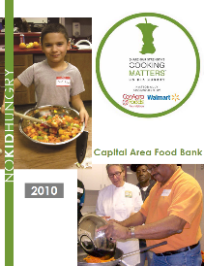
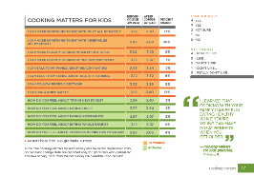
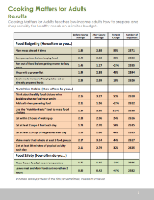
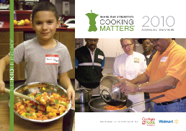
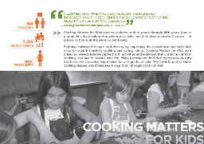
Communicating Impact
Notes:
There are three major annual reports that summarize impact data. The data from Satellite and our courses provide impact data for our program’s Lead Partner Report.

Slide 31
Next Up…
Module 2: Course Coordination, Before Class
Satellite Partner Blog
Satellite Partner Timeline
Course Coordination
Host Site Selection
Volunteer Training
Course Materials Preparation
Notes:
This concludes our Fundamentals of Cooking Matters training module.

