Slide 1
Lesson Four: You’re the Chef
Goal: Encourage teens to prepare more meals and snacks at home.
Notes:
This lesson encourages the teens to prepare food at home when possible, but also acknowledges that we often need to eat on the go and select healthy food outside the home. The teens will talk about how to prepare healthy snacks and navigate eating out today, and have time to practice their new skills.

Slide 2
Introduction
Facilitator
Review
See what teens remember
Sum up last week
Ask about weekly challenge
Introduce the new lesson
Get the teens excited
Share theme
Explain flow of class
Notes:
You may notice that this slide is identical to the introduction slide for the previous class. The teens should be familiar with the pattern by now, and the facilitator should open the class in the usual manner.
Some of this lesson’s suggested recipes have significant cook time, so be sure to discuss which recipe you will use with the teaching team before class so you can plan the flow of class accordingly. If you have the needed ingredients and an oven with sufficient space, we would recommend trying Baked Flaked Chicken and Sweet Potato Fries. As you can see in your instructor guide, the lesson is structured to jump right into cooking today so you have sufficient time, but you can always modify the schedule if you choose a recipe like Stove Top Mac and Cheese that requires less time.

Slide 3
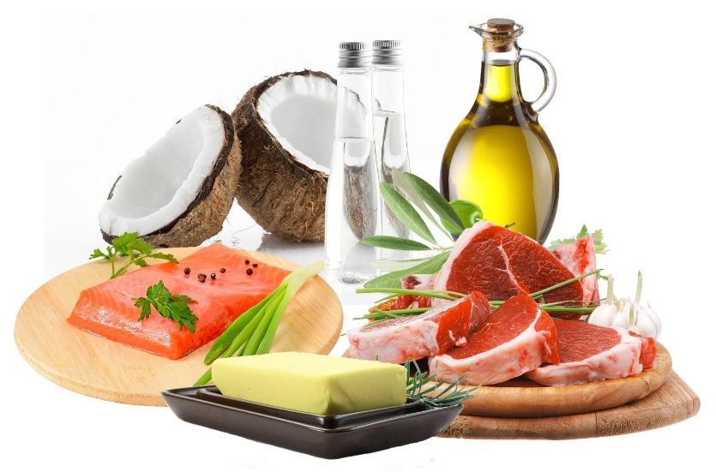
Cooking & Nutrition
Nutrition
Instructor
Culinary
Instructor
Objective: Prepare a meal using lean cooking techniques
Introduce Lean Cooking
Use recipe for context
Broaden discussion to other foods
Introduce Types of Fat
Keep discussion on level of your group
Apply discussion to example foods
Explain methods to include healthy fats in moderation
Talk about the types of fat in the context of actual foods
Notes:
The nutrition and culinary instructors should begin cooking in the usual manner, asking the teens to wash their hands and then read over the recipe. Using the recipe of the day as context, ask the teens to identify ingredients and cooking techniques that make the recipe healthier than a the normal restaurant version. After talking about the recipe of the day, broaden your conversation to include a discussion of ingredient substitutions and other recipe adaptations as seen on the handout on page 20.
The nutrition instructor should transition the conversation to focus on the different types of fat. Discuss what the types are, which should be emphasized to avoid adverse health effects, and that fat is needed in moderation for a healthy diet. Be sure your discussion of fats includes examples of actual foods. For example, if you encourage teens to try to limit trans fats, identifying foods that often have trans fats, like baked goods, helps the teens know how to act on what they just learned. Keep in mind the age level of your teens when deciding how in-depth to get in this discussion.

Slide 4
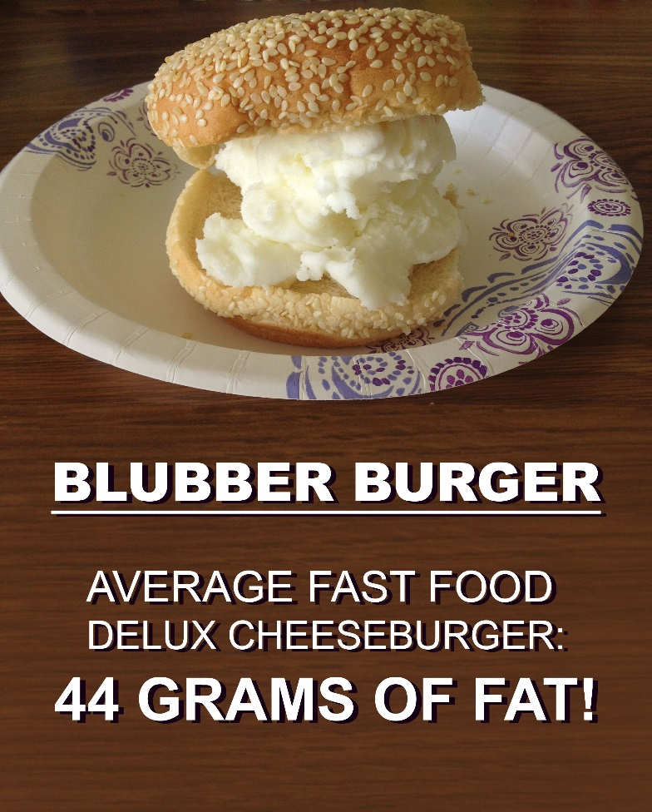
Nutrition
Nutrition
Instructor
Objective: Practice identifying healthier choices when eating out
Blubber Burger Activity
Explain activity purpose: to visualize the fat in a common fast food meal
Facilitate activity
Empower Change
Ask for ideas of healthy substitutions
Refer to book handouts
Notes:
One activity that has proven very effective in teaching about the fat content of fast food is the Blubber Burger activity on page I-22 in your instructor guide. Many restaurants have their nutrition information posted online, and the class facilitator can print out a selection of menus before class if you choose to use them for this activity. Explain that the purpose behind this activity is to visualize the amount of fat in a typical fast food meal, and ask the teens to select an entre, drinks, and sides for a meal they would usually choose when eating out. Guide the teens through the activity as outlined in your instructor guide, and regroup to talk about their reactions at the end.
The nutrition instructor should be sure to always bring the conversation back to steps the teens can use to make healthier choices. Instead simply telling them not to eat french fries, for example, ask what ideas they have for ways to make a healthier choice for their side. Refer to the “Menu Mania” handout on page 20 for helpful tips and tricks, and be sure to discuss how teens can find information about the food they are offered when eating out.

Slide 5
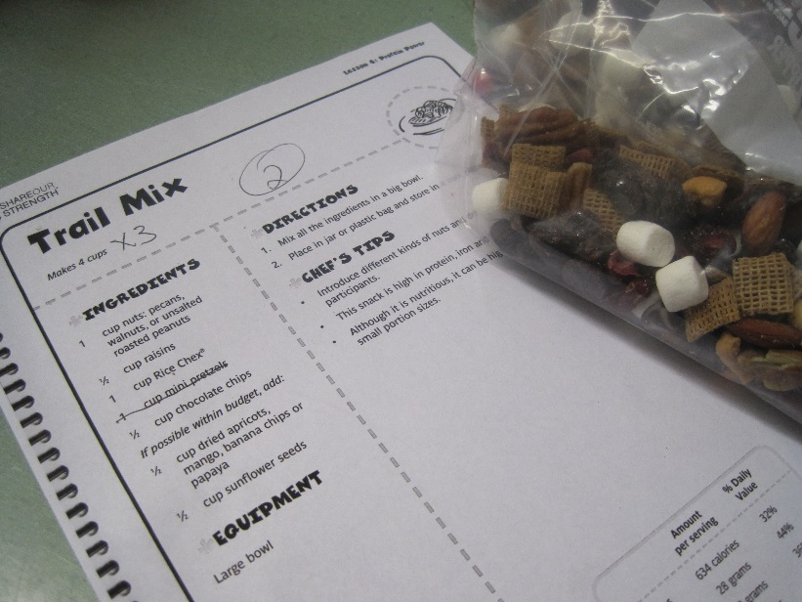
Cooking & Nutrition
Nutrition
Instructor
Objective: Practice identifying healthier snack choices
Smart Snacking
Connect to fats discussion and reading labels
Include hands-on practice
Refer to handout for examples
Trail mix recipe from snack section of teen’s book
Notes:
To wrap up the nutrition lesson for today, the nutrition instructor should apply the same lessons about fats and eating out to snack foods. Explain that convenience foods, prepackaged items we tend to eat for snacks, have many of the same nutritional qualities as fast food. Just like with eating meals away from home, eating snacks away from home can make it a challenge to eat healthy, so encourage the teens to plan ahead and make their own snacks when possible. You can also point out that preparing your own food can often save you money too.
Try to include time for hands-on practice with labels, using snack foods brought in by your facilitator if possible. This will help the teens review what they know about nutrition labels. If you have time, consider including the Snack Challenge outlined in your instructor guide to offer points the winning Extreme Food Makeover team.

Slide 6
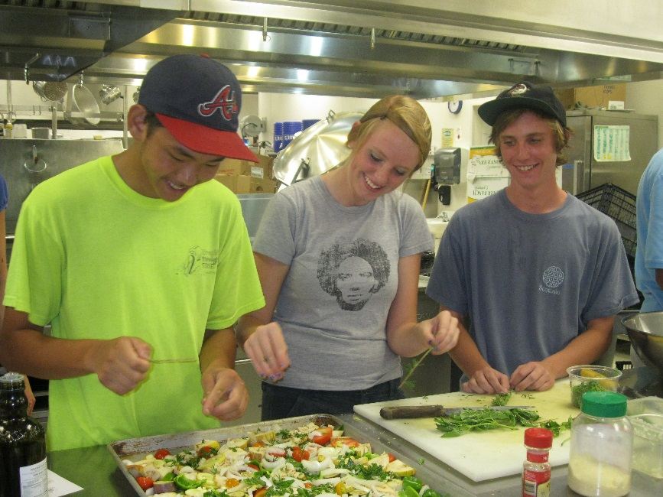
Extreme Food Makeover
Facilitator
Revisit the Handout:
Distribute challenge handout
Direct teens to complete lean cooking questions
Select dishes and note ingredients
Teens choosing to roast instead of fry veggies
Notes:
This week’s revisiting of the Extreme Food Makeover challenge is budgeted 20 minutes because the teens will not only be answering the lean cooking questions, but they will also make decisions about what they will be preparing for the final challenge. After answering the questions about lean cooking techniques, the teens should make the final decision on what they will be preparing during the challenge. Ask them to draft a list of the ingredients they will need to prepare those recipes and mention that you will be using it for the grocery store tour next week. Discuss why shopping with a list is helpful for saving money, eating healthy, and saving time.
Creating a list this week will not only help the teens practice, but it will also give the facilitator time to start gathering materials for the final class.

Slide 7
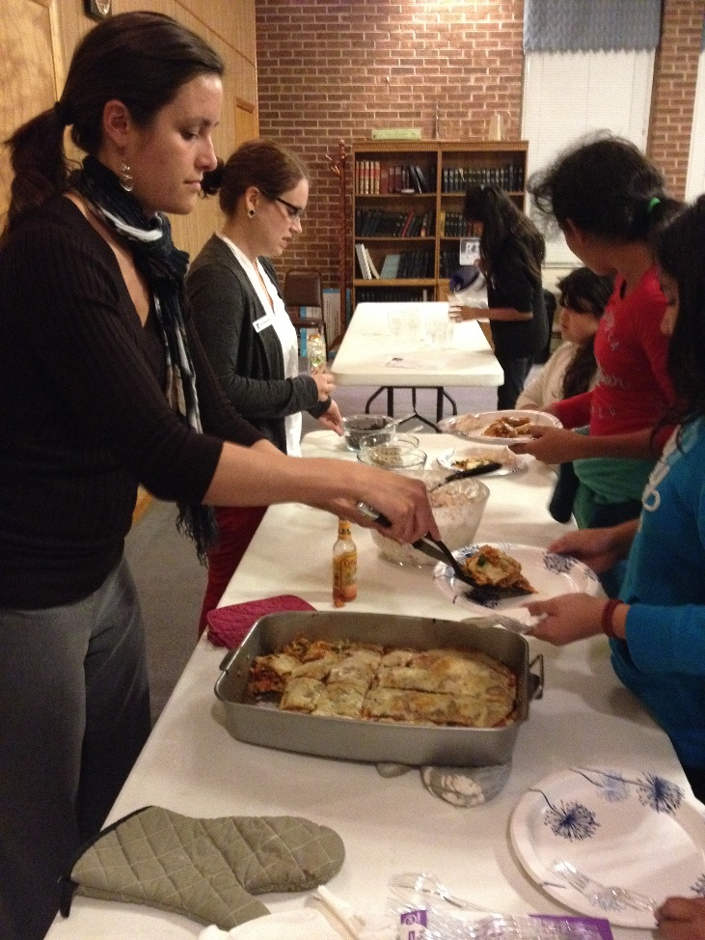
Eating Together
Facilitator
Continue Learning While Eating
Discuss how to apply lesson in daily life
Wrap Up
Summarize the lesson
Discuss new weekly challenges
Clean up as a group
Distribute take-home groceries
Debrief
Notes:
While eating together today, continue discussing the key messages you went over today and answer any remaining questions the teens have. Have the teens discuss the weekly challenge and choose what they would like to try. After cleaning up together, say good-bye to the teens and meet for your closing huddle with the teaching team.

