Slide 1
Lesson Four: The Power of Planning
Goal: Encourage participants to plan healthy, low-cost meals and make the most of their food dollars.
Notes:
After Lesson 3’s discussion of the challenges of eating healthily while eating out, Lesson 4 equips participants to plan ahead and prepare healthy, low-cost food at home.

Slide 2
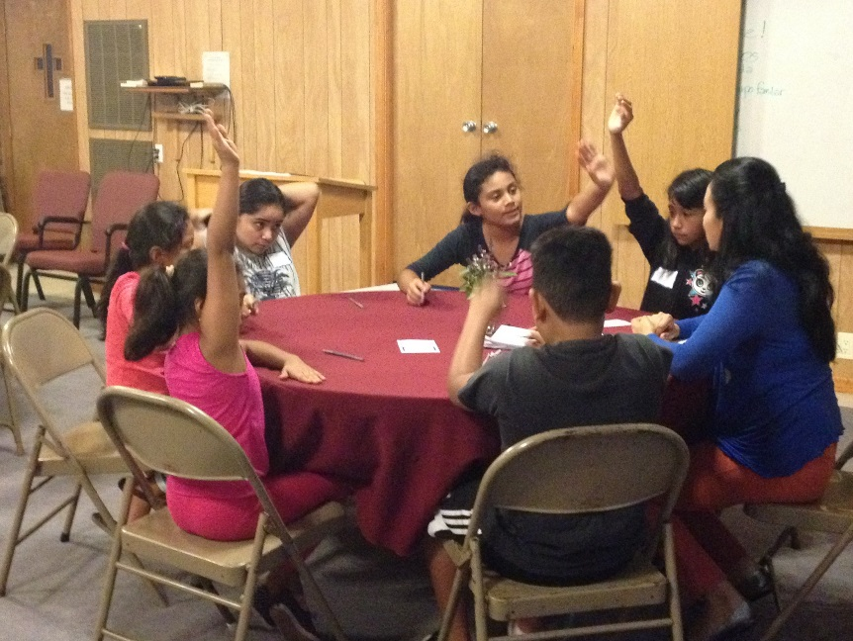
Introduction
Facilitator
Review
Open discussion to see what they remember
After hearing comments, sum up last week’s theme
Ask how the weekly challenge went
Introduce the new lesson
Start with questions to get the participants involved
Share theme
Explain flow of class
Notes:
You may notice that this slide is identical to the introduction slide for the previous class. The participants should be familiar with the pattern by now, and the facilitator should run through the same review and sharing process. Although the steps are the same, however, the sharing time is still important, so don’t be afraid to spend a few minutes here listening as the class shares their experiences. Congratulate those who met their goals and encourage those who report needing to continue with their work.
After introducing Lesson 4, the facilitator should turn it over to the nutrition instructor.

Slide 3
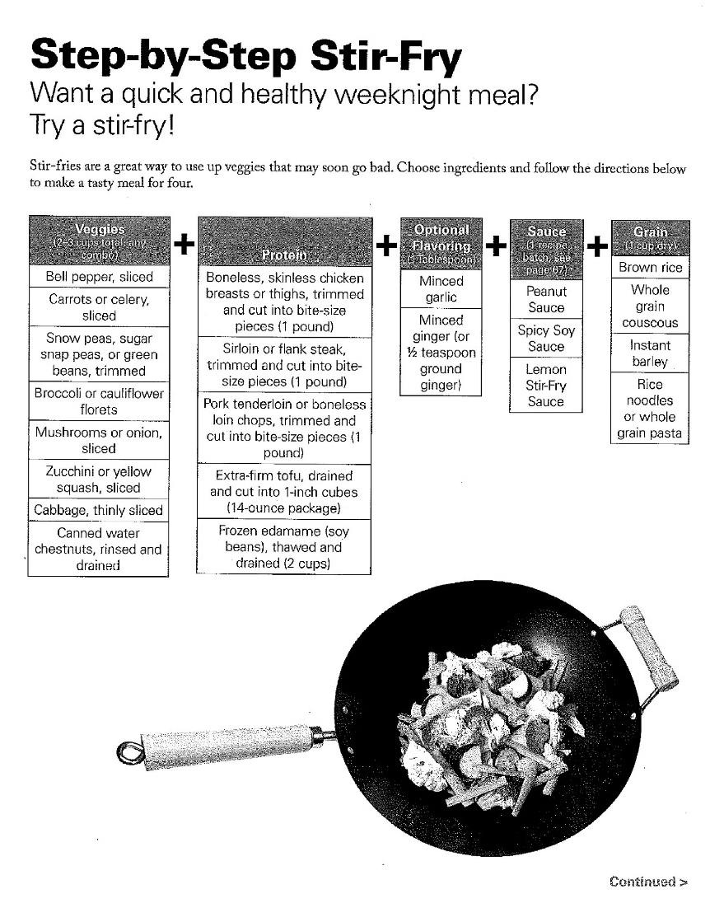
Nutrition
Nutrition
Instructor
Introduce Menu Planning
Ask how they currently decide what to cook
Point out benefits: saves time, saves money, can improve nutrition
Explore Resources
Templates on p. 61-72
Recipe template example; p. 66
Notes:
The nutrition instructor should start the lesson off by asking how participants usually make decisions about and prepare for their meals. Using the talking points in the instructor guide and the “Menu Planning Basics” handout on page 48, introduce the idea of menu planning and talk about the simple steps that can make healthy meals easier to fit into everyday life. Revisit the concept of recipe frameworks you introduced in Lesson 1 and point out the resources located in the participants’ books on pages 61-72.

Slide 4
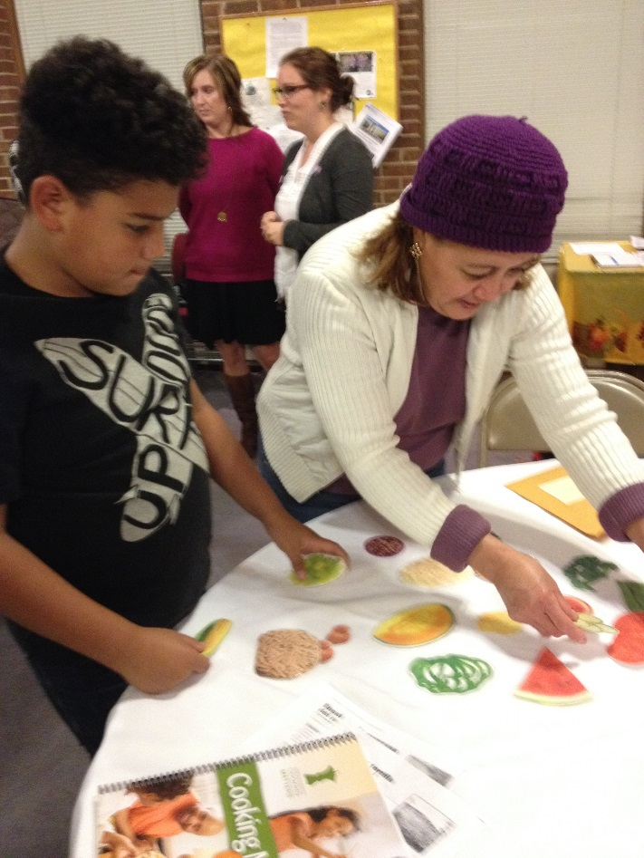
Nutrition
Nutrition
Instructor
Objective: Practice planning meals in advance
Practice Menu Planning
Use “Ready, Set, Plan!” activity on p. I-26
Encourage participants to use book resources and personal recipes
Consider bringing food photos to help spark ideas
Notes:
Before you transition out of your discussion on meal planning, give the participants a chance to practice what they are learning by completing the “Ready, Set, Plan!” activity on page I-26 as a class or in smaller groups. Consider bringing cut out pictures of foods to help their brainstorming. After a few minutes, ask if anyone would like to share what they have planned. You can also turn the activity into a challenge by distributing a few photos to each participant and asking them to plan a meal based on those ingredients.

Slide 5
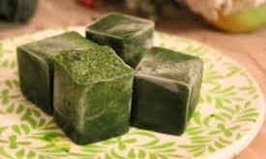
Cooking and Food Safety
Culinary
Instructor
Objective: Prepare recipes using herbs and spices instead of salt.
Discuss seasoning with herbs
Easy and economical to grow your own
Can dry or freeze when you find an affordable source
Food Safety
Discuss thawing meat and other foods
Purchase herbs in bulk when in season and freeze
Notes:
The nutrition instructor should then pass it over to the culinary instructor once again for a discussion about seasoning foods with herbs and spices instead of salt. This is a great place to tie in past discussion about convenience foods and point out that preparing food yourself can give you more control of how much sodium you are eating.
Ask participants what kind of spices they generally use and discuss ways to make fresh seasonings affordable. To go above and beyond for this lesson, consider including small potted herbs as part of the participants’ take-home groceries if you can find a donor willing to contribute these.
Today’s culinary lesson also includes a discussion of thawing food safely. After talking about cooking large recipes and using the freezer to preserve them, this is an important topic to cover in order to ensure participants know how to thaw and use their food safely.

Slide 6
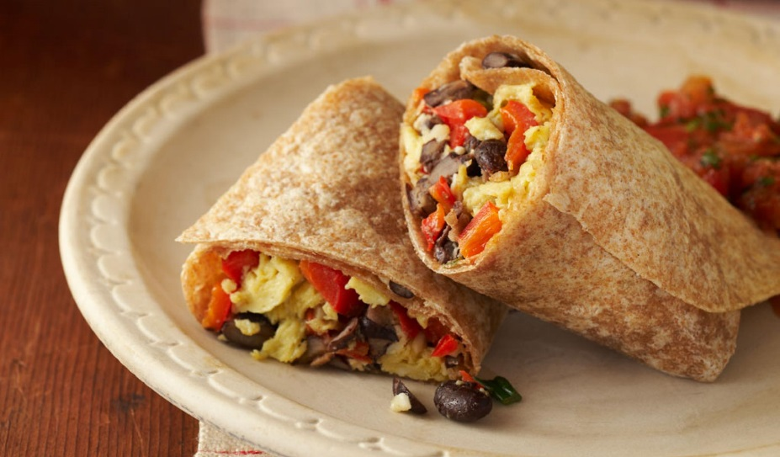
Nutrition
Nutrition
Instructor
Objective: Practice identifying breakfasts that can be made in 5 minutes or less
Breakfast Discussion
Share current breakfast habits
Talk about barriers and benefits to breakfast
Make the discussion concrete: brainstorm options participants would consider eating
Point out recipes in book
Notes:
After cooking, the culinary instructor should turn it back over to the nutrition instructor to finish up the nutrition portion of the lesson. Introduce the topic of starting each day with a healthy breakfast and talk to the class about ways to make this possible for their schedules, using the instructor guide to structure your conversation. Be sure to refer back to the time saving and planning ahead techniques you discussed earlier in this lesson, and see how the participants can apply them to breakfast. For example, you can prepare a batch of breakfast burritos on a weekend and freeze them to make breakfast an easy grab-and-go meal for hurried mornings. You can also tie in discussion about adapting recipes using any vegetables you have on hand in a strata recipe, or using extra fruit in a parfait.

Slide 7
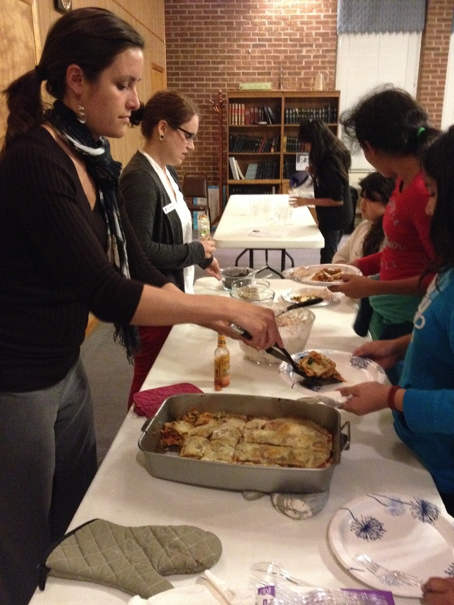
Eating Together
Facilitator
Continue Learning While Eating
Discuss how to apply lesson in daily life
Wrap up
Summarize the lesson
Discuss new weekly challenges
Clean up as a group
Distribute take-home groceries
Debrief
Notes:
While eating together today, continue discussing the savings that can result from shopping from a list and planning meals so food that’s been purchased doesn’t go to waste before it’s used.
If you have many participants with children, consider talking about how children are more likely to try healthy or new foods if they help select and prepare them. Meal planning and shopping can be a helpful activity for improving the health of the whole family.
The facilitator should transition the class into the weekly challenge discussion time and let the participants share what they’ve selected to work on. After the participants clean up together, the teaching team can distribute the take-home groceries and meet for their final debrief huddle.

